Slide 2
Common Exception Cross Word
Day 1
Spelling Focus – S37: Common Exception Words
Can you solve the cross word and find the secret code by spelling some common exception words correctly?
 |  |  | 1
 |  |  | 2
 |  |  |  |  |  |  | 3
 |  |  |  |  | 4
5
 |  |  |  |  |  |  |  |  |  | 6
 |  |  |  |  |  |  | 7
Across
2. The part of the human body used to see.
5. Celebrated on 25th December.
7. A sweet, white grain to go into tea.
Down
1. If someone looks nice, they could be described as .
3. A conjunction which explains why something happens.
4. Another word for ‘dad’.
5. To go up something using your hands and feet.
6. The liquid that comes out of a tap.
Challenge: Can you write a sentence using the secret code and the answers to ‘2 Across’ and ‘3 Down’?

Slide 3
Common Exception Cross Word - Answers
Day 1
Spelling Focus – S37: Common Exception Words
Did you solve the cross word and find the secret code by spelling some common exception words correctly?
 |  |  | 1
 |  |  | 2
 |  |  |  |  |  |  | 3
 |  |  |  |  | 4
5
 |  |  |  |  |  |  |  |  |  | 6
 |  |  |  |  |  |  | 7
 |  |  | e | y | e
c | h | r | i | s | t | m | a | s
 |  |  | e | y | e
 |  |  | b
 |  |  | e | y | e
 |  |  | a |  |  |  | b
 |  |  | u |  | f |  | e
 |  |  | t |  | a |  | c
c | h | r | i | s | t | m | a | s
l |  |  | f |  | h |  | u
i |  |  | u |  | e |  | s | u | g | a | r
m |  |  | l |  | r |  | e
b
 |  |  | e | y | e
c | h | r | i | s | t | m | a | s
 |  |  |  |  |  |  | s | u | g | a | r
 |  |  | b
 |  |  | e | y | e
 |  |  | a
 |  |  | u
 |  |  | t
c | h | r | i | s | t | m | a | s
 |  |  | f
 |  |  | u |  |  |  | s | u | g | a | r
 |  |  | l
 |  |  | b
 |  |  | e | y | e
 |  |  | a |  |  |  | b
 |  |  | u |  |  |  | e
 |  |  | t |  |  |  | c
c | h | r | i | s | t | m | a | s
 |  |  | f |  |  |  | u
 |  |  | u |  |  |  | s | u | g | a | r
 |  |  | l |  |  |  | e
 |  |  | b
 |  |  | e | y | e
 |  |  | a |  |  |  | b
 |  |  | u |  | f |  | e
 |  |  | t |  | a |  | c
c | h | r | i | s | t | m | a | s
 |  |  | f |  | h |  | u
 |  |  | u |  | e |  | s | u | g | a | r
 |  |  | l |  | r |  | e
 |  |  | b
 |  |  | e | y | e
 |  |  | a |  |  |  | b
 |  |  | u |  | f |  | e
 |  |  | t |  | a |  | c
c | h | r | i | s | t | m | a | s
 |  |  | f |  | h |  | u
 |  |  | u |  | e |  | s | u | g | a | r
 |  |  | l |  | r |  | e
 |  |  | b
 |  |  | e | y | e
 |  |  | a |  |  |  | b
 |  |  | u |  | f |  | e
 |  |  | t |  | a |  | c
c | h | r | i | s | t | m | a | s
l |  |  | f |  | h |  | u |  |  | w
i |  |  | u |  | e |  | s | u | g | a | r
m |  |  | l |  | r |  | e |  |  | t
b |  |  |  |  |  |  |  |  |  | e
 |  |  |  |  |  |  |  |  |  | r
Across
2. The part of the human body used to see.
5. Celebrated on 25th December.
7. A sweet, white grain to go into tea.
Down
1. If someone looks nice, they could be described as .
3. A conjunction which explains why something happens.
4. Another word for ‘dad’.
5. To go up something using your hands and feet.
6. The liquid that comes out of a tap.
Challenge: Did you write a sentence using (the secret code) (tear) and (the answers to ‘2 Across’) (eye) and (‘3 Down’) (because)?
‘I had a tear in my eye because I felt upset.’

Slide 4
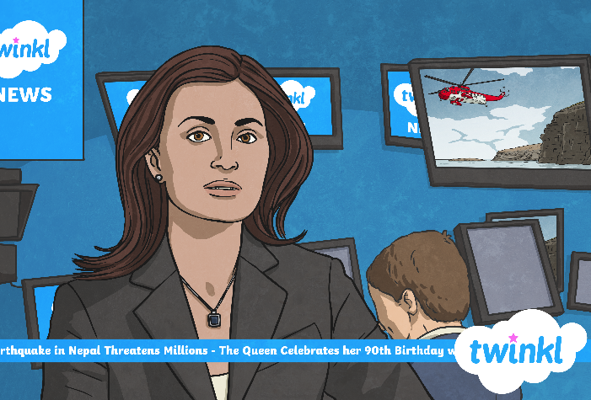
Day 2
Grammar Focus – G1.2: Verbs.
Playtimes Make Headlines
All of the children run across the playground. Salim slips in a muddy puddle so he washes his hands and wipes his trouser leg. Becky and Nora get the big skipping rope out of the hall and swing it while Sophie jumps. Tyler chases Josh while Abdul slides down the green, plastic slide. When Mr Adam blows the whistle, the children quickly tidy away their toys and line up smartly.
Can you make a list of all of the verbs she used in her recording?
Challenge: Can you change all of the verbs she used into the past tense, to help her to write her news article about it?

Slide 5
Day 2
Grammar Focus – G1.2: Verbs.
Playtimes Make Headlines - Answers
All of the children run (ran) across the playground. Salim slips (slipped) in a muddy puddle so he washes (washed) his hands and wipes (wiped) his trouser leg. Becky and Nora get (got) the big skipping rope out of the hall and swing (swung) it while Sophie jumps (jumped). Tyler chases (chased) Josh while Abdul slides (slid) down the green, plastic slide. When Mr Adam blows (blew) the whistle, the children quickly tidy (tidied) away their toys and line (lined) up smartly.
Did you make a list of all of the verbs she used in her recording?
Challenge: Did you change all of the verbs she used into the past tense, to help her write her news article about it? Which word did you sometimes need to take out?

Slide 6
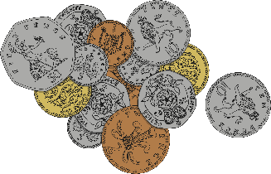
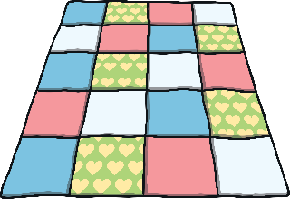
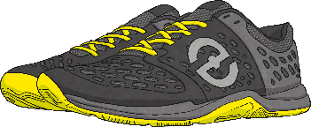
Day 3
Reading Focus – 1d: Make inferences from the text.
Mystery Mail
Three suitcases without name tags have got lost in the mail. Can you infer who they belong to by looking at what is inside?
Write a sentence using the conjunction ‘because’ to explain why you think each suitcase belongs to that person.

Slide 7
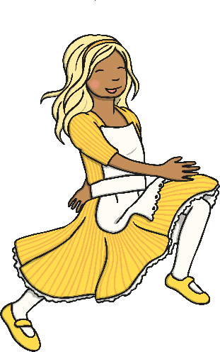
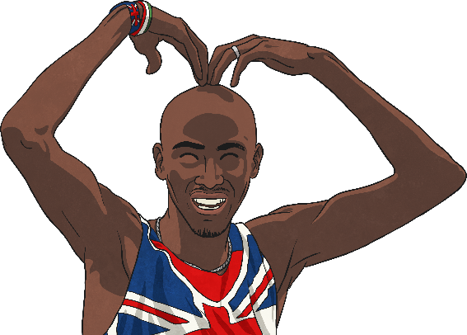
Day 3
Reading Focus – 1d: Make inferences from the text.
Mystery Mail - Answers
Were you able to infer who the suitcases belong to by looking at the contents?
I think that this suitcase belongs to Queen Elizabeth II because she wears a crown and her face is on both money and stamps.
I infer that this suitcase belongs to Mo Farah because he is British and won lots of gold medals for running at the Rio Olympics.
From the items in the suitcase, I infer that it belongs to Goldilocks because she ate the bears’ porridge and slept in their beds.

Slide 8
Day 4
Grammar Focus – G2.1 & 2.3: Statements and Commands.
Command or Statement?
Commander Cody and Statement Sadiya have dropped their sentences and they are all muddled up. Can you help them to decide if each sentence is a command or a statement?
Some people say that cats have nine lives.
The playground floor is slippery.
Put your coat on, Samuel.
“You need to go down the slide first.”
My arm is itchy.
Spread the butter using a knife.
Laura doesn’t like cheese.
A dog is chasing a bird.
Open the window, Sarah.
Rinse all of the shampoo out of your hair.
Commander Cody
Statement Sadiya
Challenge: Can you write three more sentences of each type to add to their collections?

Slide 9
Day 4
Grammar Focus – G2.1 & 2.3: Statements and Commands.
Command or Statement? - Answers
Did you manage to return all of the sentences to Commander Cody and Statement Sadiya? Let’s find out.
Some people say that cats have nine lives.
The playground floor is slippery.
Put your coat on, Samuel.
“You need to go down the slide first.”
My arm is itchy.
Spread the butter using a knife.
Laura doesn’t like cheese.
A dog is chasing a bird.
Open the window, Sarah.
Rinse all of the shampoo out of your hair.
Commander Cody
Statement Sadiya
Tuck your chair underneath the table.
Listen to me when I’m speaking to you.
Make sure you eat all of your lunch.
The chair is tucked underneath the table.
Gill listened when Zayn spoke to her.
I ate all of my lunch.

Slide 10
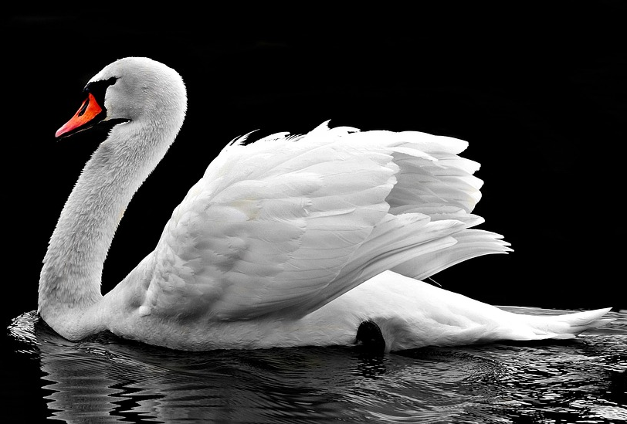
Day 5
Punctuation, Grammar and Vocabulary Focus – Mixed Skills
Think & Write
Look at this picture. What words and sentences does it make you think of? We are going to write a short piece of text based on the picture, using the following pattern of sentences:
Sentence 1
Write a sentence with an expanded noun phrase.
Sentence 2
Write an exclamation about the swan which begins with ‘What’.
Sentence 3
Write a sentence using the verb ‘swims’ in the present tense.
Sentence 4
Write a sentence containing the conjunction ‘when’.
Share your writing with a partner, your group or your whole class.

Slide 11
Day 5
Punctuation, Grammar and Vocabulary Focus – Mixed Skills
Think & Write - Answers
Look at this picture. What words and sentences does it make you think of? We are going to write a short piece of text based on the picture, using the following pattern of sentences:
The elegant, graceful swan rests on top of the icy, cold water.
What a beautiful swan it is!
The swan swims easily and gently across the lake.
The swan stops swimming when it gets too tired to continue.
What did you learn to do this week that you couldn’t do before?

