Slide 1
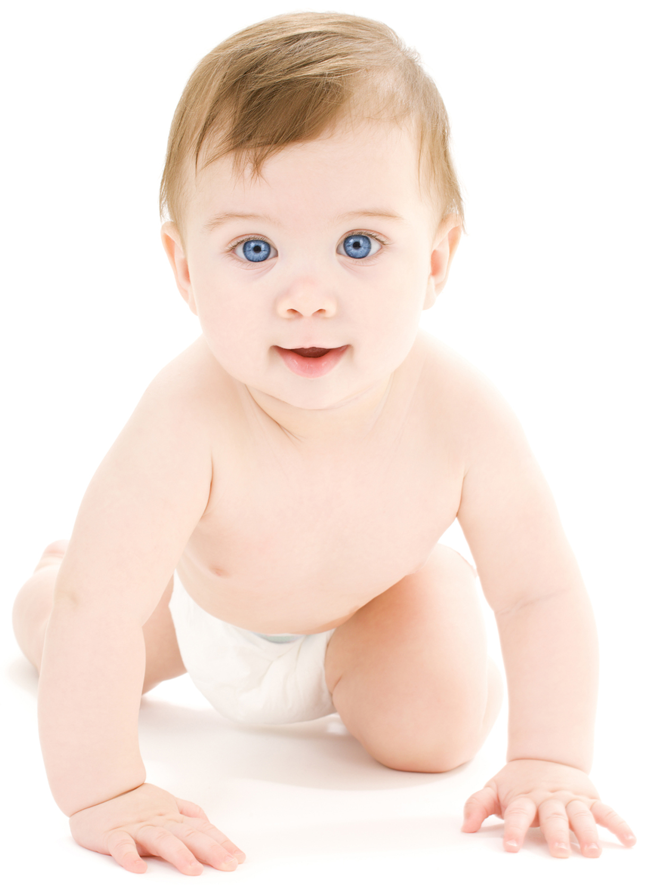
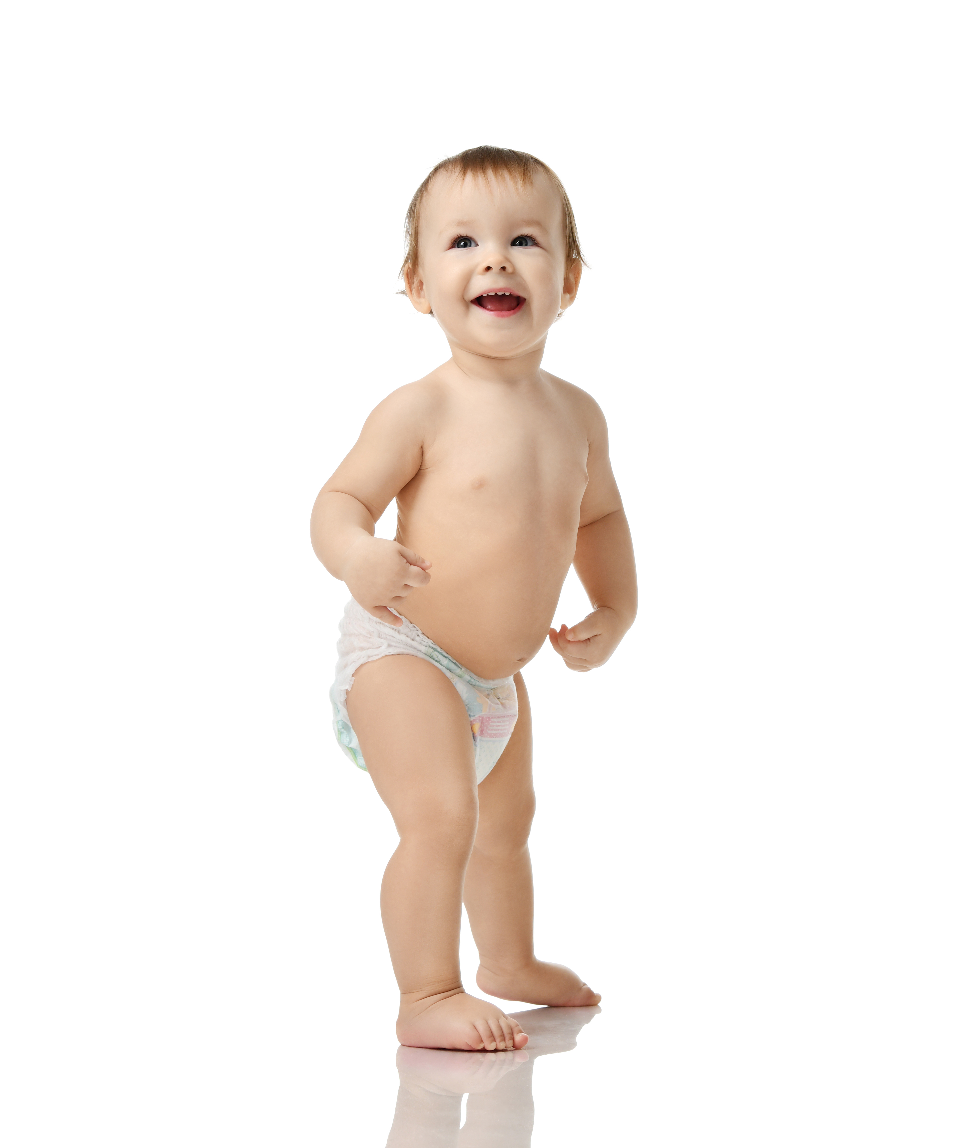
Monday 17th January 2022
LO: I can order information on a timeline.
toddler
teenager
adult
baby
child
elderly
adult
baby
child
elderly
teenager
toddler

Slide 2
Monday 17th January 2022
LO: I can order information on a timeline.
adult
baby
child
elderly
teenager
toddler

Slide 3
Monday 17th January 2022
LO: I can order information on a timeline.
What 2 stages have you completed?
____________________________
____________________________
What stage are you currently in?
_______________________________
adult
baby
child
elderly
teenager
toddler

