Slide 1
Brady Primary School
Reception 2021-2022

Slide 2
We are so pleased that you are considering coming to join the Reception classes at Brady Primary School.
This is the start of a very exciting time in your life. There will be lots of children for you to play and learn with, and lots of very kind grown ups to look after you.
We work hard to make sure you feel very happy and safe here and we promise to make sure your school experience is the very best we can possibly offer.
Who Will Be My Teacher?
Hello! We are Mrs Divall and Mrs Zaayman and Mrs Degun. We have two reception classes – Acorn Class and Cedar Class.
If you are in Acorn Class, Mrs Divall will be your teacher on a Monday, Tuesday and Wednesday and Mrs Zaayman will be your teacher on a Thursday and Friday.
If you are in Cedar, Mrs Degun will be your teacher. There are also several lovely support staff who help us to learn in reception.
Mrs Divall leads Nursery and Reception, and Mrs Zaayman is the Deputy Headteacher and head of Special Educational Needs.
Welcome

Slide 3
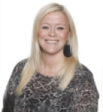
Meet the Teachers
Favourite story:
The Ugly Five
Favourite colour:
Red
Favourite food:
Minty sweets
Favourite song:
The wheels on the bus
Favourite story:
The Gruffalo
Favourite colour:
Yellow
Favourite food:
Birthday cake
Favourite song:
Cecil the caterpillar
Mrs Zaayman
Deputy Head/SENCO
Mrs Divall
Reception Teacher
EYFS/Literacy
Lead
Staff
Favourite story:
Elmer
Favourite colour:
Purple
Favourite food:
Sausages and mash
Favourite song:
Wind the bobbin up
Mrs Degun
Reception Teacher

Slide 4
Are you currently going to pre-school or nursery?
If not, come and join us at Brady now!
We currently have spaces for children to start Nursery (they must be at least 3 years old) from January 2021.
Our Nursery is located within our wonderful new school building, with an all weather outdoor area and a qualified teacher leading the learning in the setting with two wonderful and experienced support staff.
Please contact the school office for further information!
Nursery

Slide 5
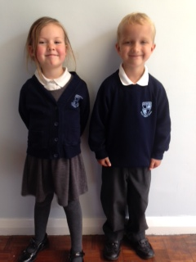
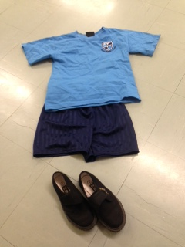
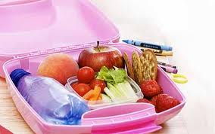
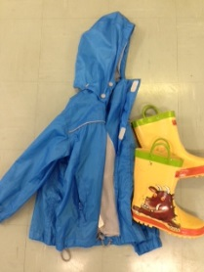
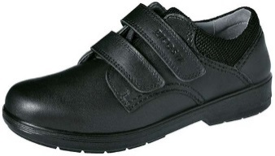
What will you need for school?
Uniform
PE kit
A Healthy Packed lunch or
you can choose a yummy
hot meal for free!
Belongings
Coat & Wellies
Black School shoes
Please make sure all your belongings are labelled with your name!

Slide 6
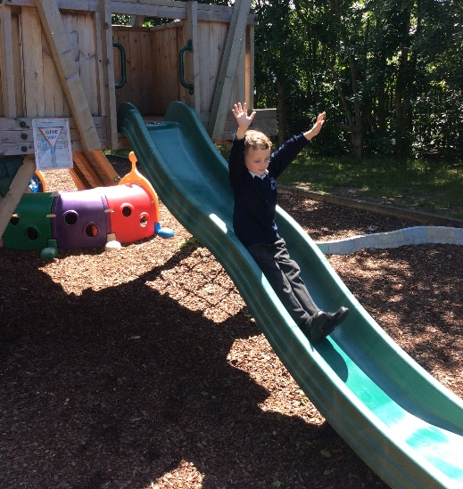
It is important that you come to school at the right time and that you come every day!
The school day starts at 8.45am and currently finishes at 2.45pm.
We do have a breakfast and after school club provision, run by the school, on site.
Everyday you will be able to go outside, so don’t forget your coat and welly boots! We are very lucky because we have a great big garden to explore too.
School day
Every Wednesday we do P.E. with our PE coach Mr Reynolds. Currently during the pandemic we wear our PE kit all day on a Wednesday.

Slide 7
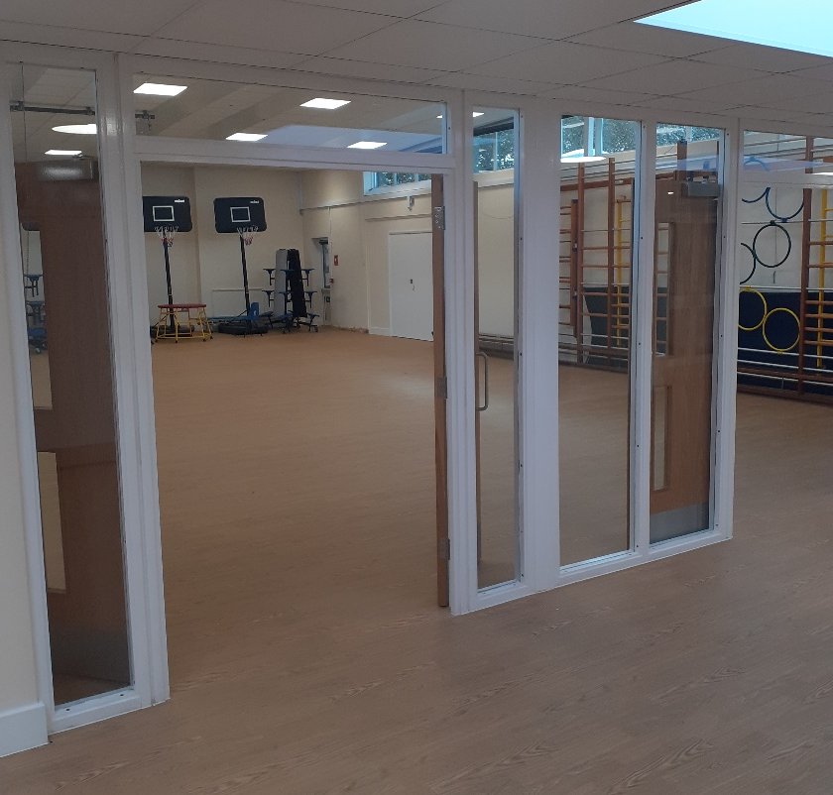
This is what our hall looks like. We do some of our PE lessons in here. At lunchtime special tables are put out, and we eat our lunch here.
Hall
You can have a free hot meal in Reception, Year One and Year Two. They are tasty, healthy and will fill you up, ready to learn in the afternoon. If you prefer, you can bring a lunchbox to school with healthy food in it. We save sweets and chocolate for after school, so please ask your grown ups to only pack you healthy snacks.

Slide 8
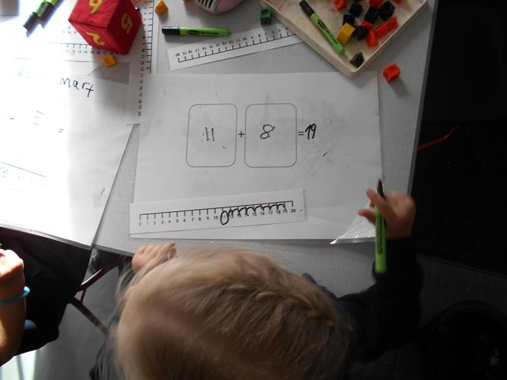
Look at some of the learning you will take part in at school!
In Reception, our curriculum is so exciting and engaging.
The children have a Literacy, Maths, Phonics and Topic carpet session each day.
They also have optional and compulsory small group work which they will come to participate in.
In between these structured learning times there are periods of time for children to explore the indoor and outdoor environment independently.
During this time, staff support learning through play, ensuring your children are learning without even realising!
Learning

Slide 9
Reading
After a few weeks your teacher will give you a reading book to take home to read with an adult at home. You should keep this book in your book bag. Don’t forget to bring it to school everyday. We will change this book every week and you must read it with a grown up at least 3 times a week. You can win prizes for practising your reading!
Daily reading practice, retelling stories and reading aloud will help you become a super reader.
We’re very lucky that we have our own library at Brady, and each week you will be able to choose a book to take home and share with your grown-ups.
As our school is absolutely brand new – our new library is currently being set up by Mrs Agates. We will be able to show you a picture of this later on in the year.
School & Home
Phonic sounds taught and Key Reception words will be given to you by your class teacher.

Slide 10
Additional websites
Oxford Owl is a free website built to help and support parents with their children’s
learning.
www.oxfordowl.co.uk
For phonics practise go to Phase 1 activities
Websites
www.letters-and-sounds.com
www.phonicsplay.co.uk

Slide 11
If you do decide Brady is the right school for you, make sure you fill out the Havering admissions form by January. Don’t miss the deadline!
If your child is allocated to us, you can expect to hear from us around May, once Havering Local Authority release the data to us. We will then notify you of our transition process, usually this consists of stay and play sessions and a home visit – however, as you can imagine this year has been slightly different due to the pandemic.
Either way, we will meet you and your child and get to know you before they begin their new learning journey in September.
And finally…

