Slide 1
YEAR 1
Geometry (Shape)
Recognise and name 3D shapes
Recognise and name 2D shapes
Sort 3D shapes
Sort 2D shapes Patterns with 2D and 3D shapes
Block 3 – Week 10

Slide 2
Lesson 1
Step: Recognise and name 3D shapes
https://www.bbc.co.uk/bitesize/clips/zps34wx

Slide 3
Match the shape to its name.
Cube
Pyramid
Cone
Cuboid
Sphere
Cylinder

Slide 4
Name the shape.
Cube

Slide 5
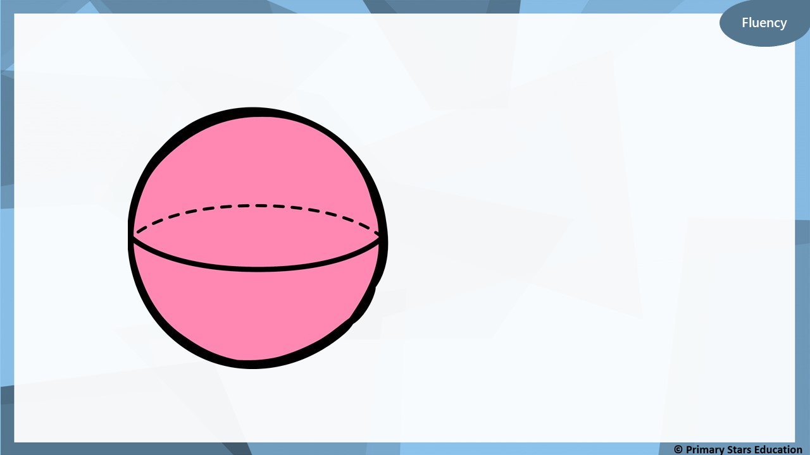
Name the shape.
Sphere

Slide 6
Name the shape.
Cuboid

Slide 7
Name the shape.
Cylinder

Slide 8
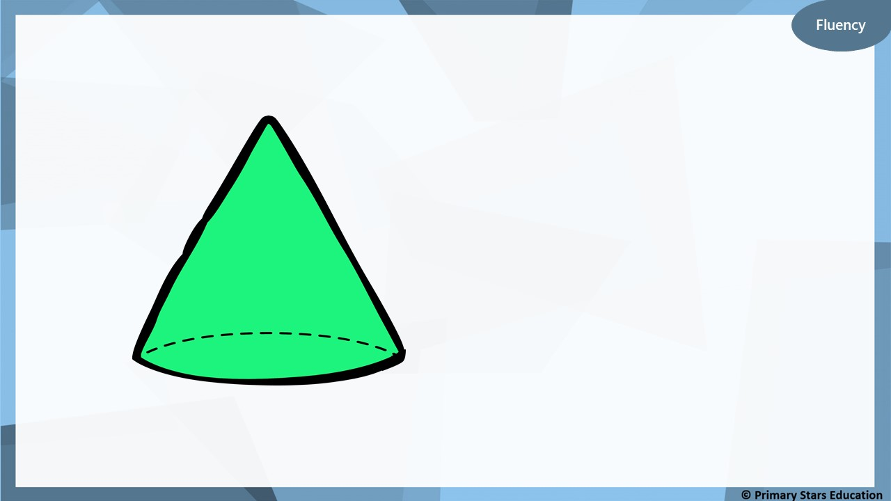
Name the shape.
Cone

Slide 9
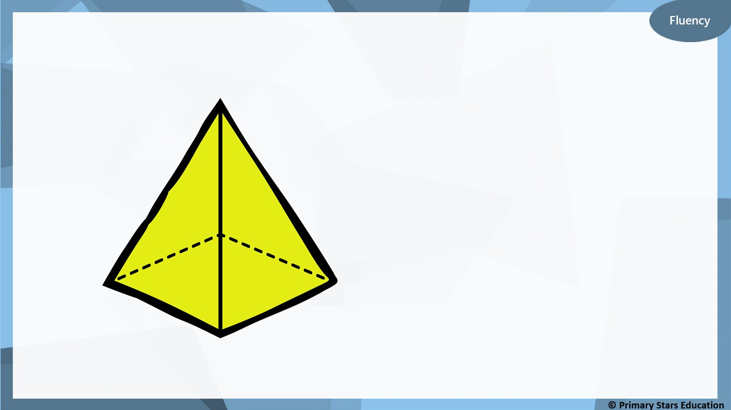
Name the shape.
Pyramid

Slide 10
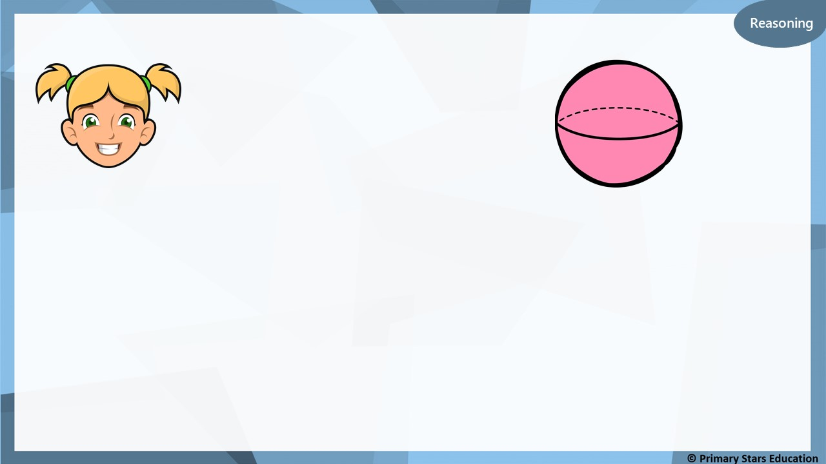
This shape is a cylinder.
Is Kat correct?
Explain how you know.
No. The shape is a sphere as it only has 1 curved face.
A cylinder has 3 faces (1 curved face and 2 flat faces).

Slide 11
This shape is a cone.
True or false?
Explain how you know.
False. The shape is a pyramid as the base is a square.

Slide 12
Part of this shape is hidden from view.
Cube
What shape is this? ____________
Explain how you know.
Three square faces can be seen, therefore it must be a cube.

Slide 13
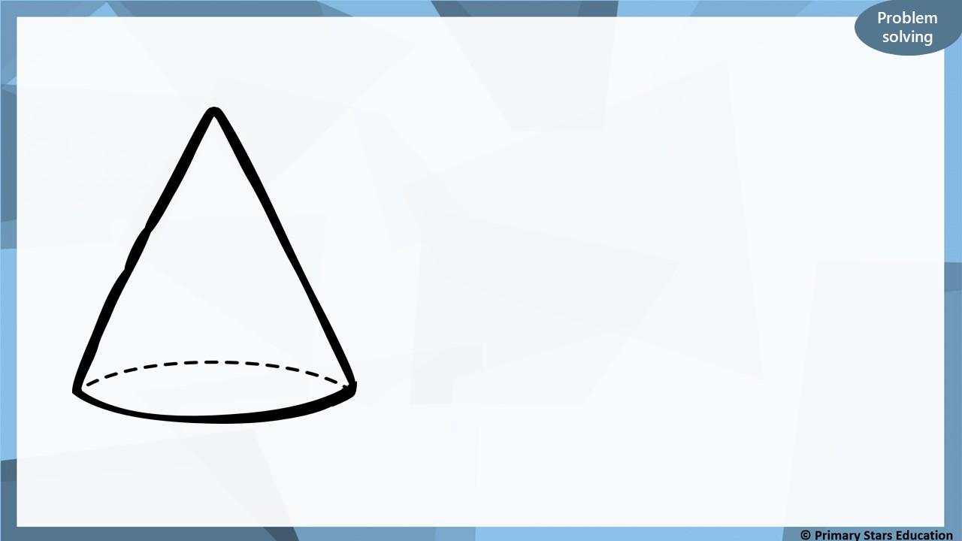
Part of this shape is hidden from view.
Cone
What shape is this? ____________
Explain how you know.
The shape has a point and curved face, therefore must be a cone.

Slide 14
Lesson 2
Step: Sort 3D shapes

Slide 15
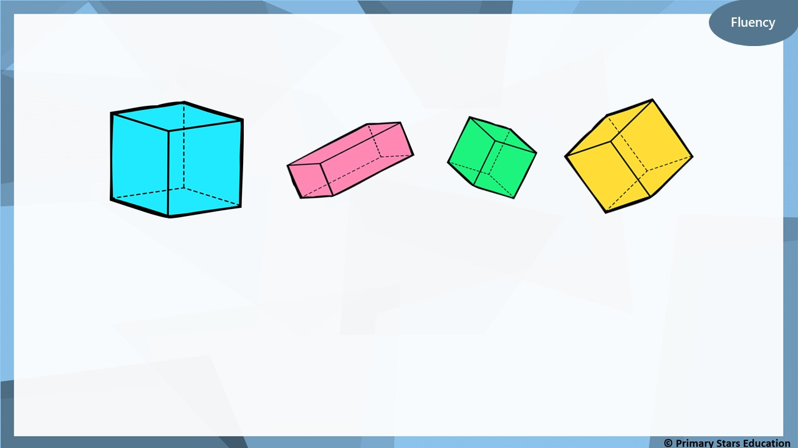
Which is the odd one out?
Explain how you know.
This shape is a cuboid.
The other shapes are cubes.

Slide 16
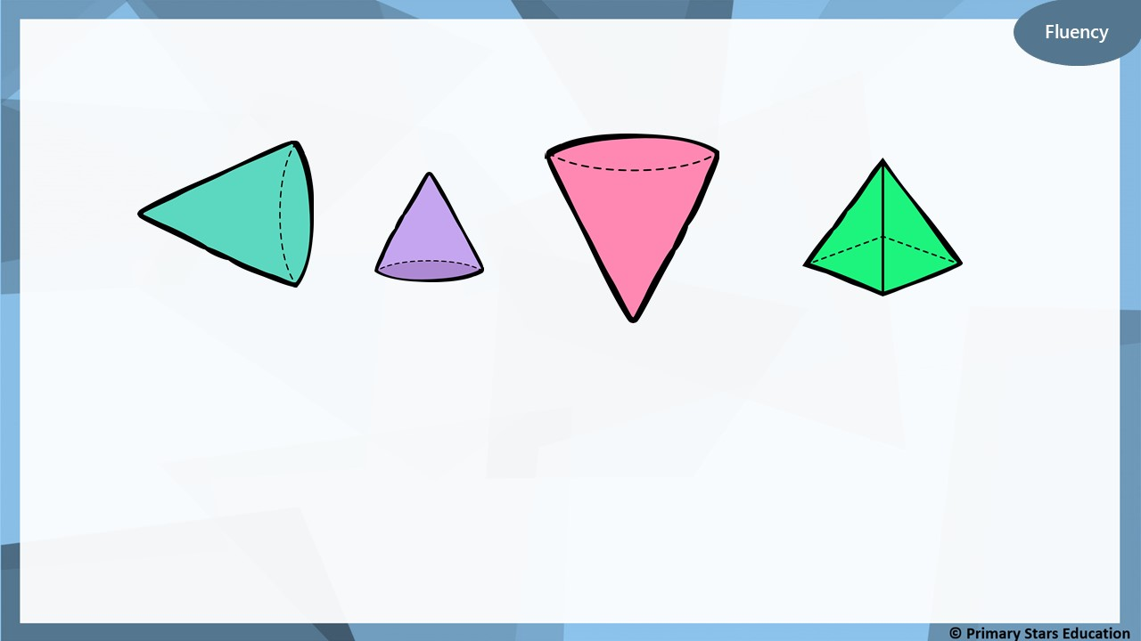
Which is the odd one out?
Explain how you know.
This shape is a pyramid.
The other shapes are cones.

Slide 17
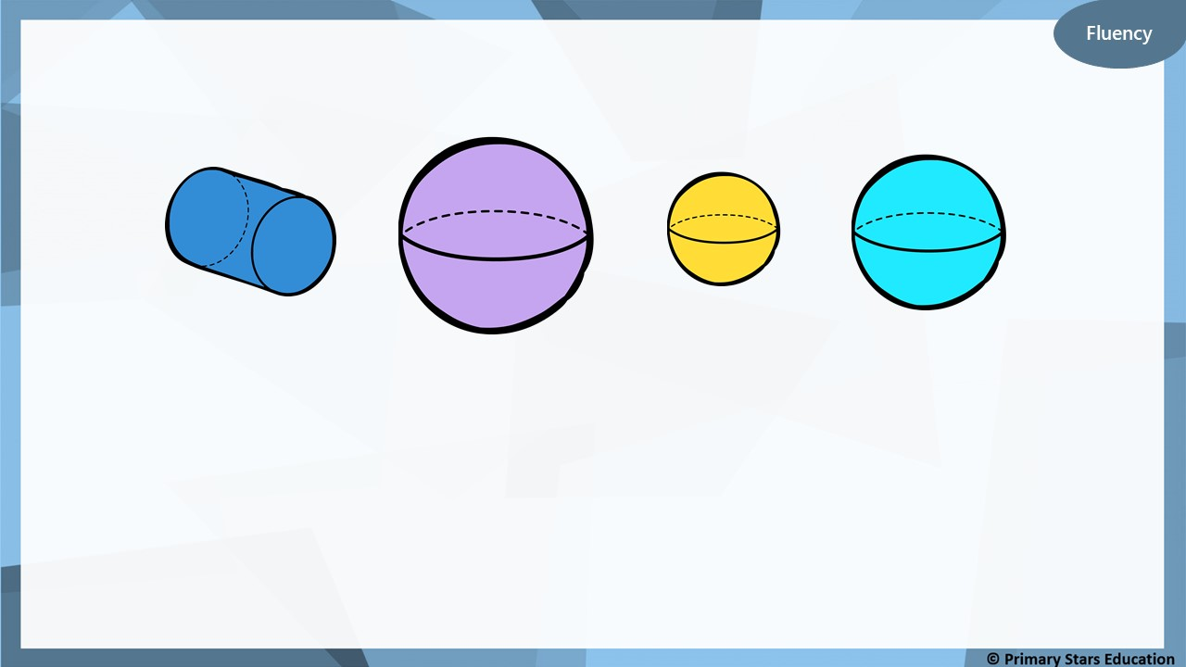
Which is the odd one out?
Explain how you know.
This shape is a cylinder.
The other shapes are spheres.

Slide 18
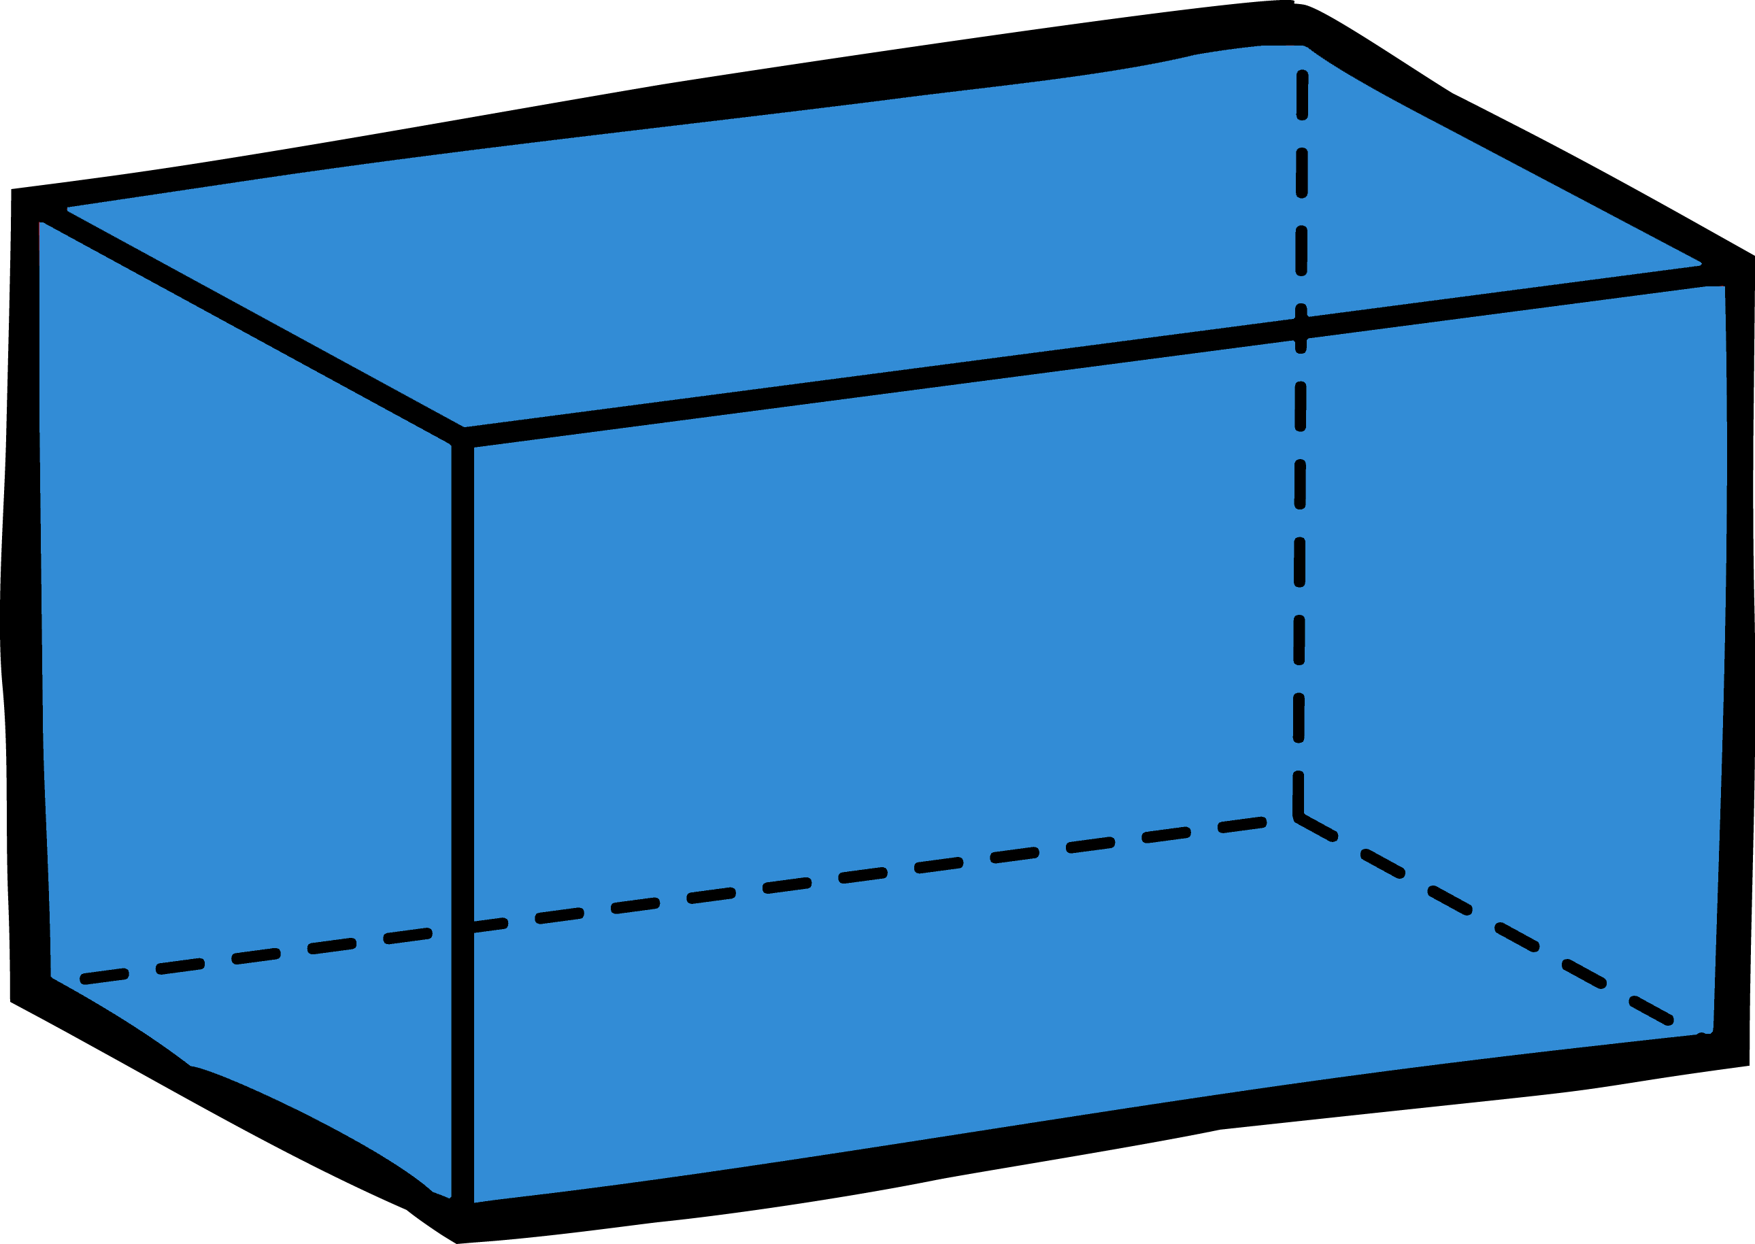
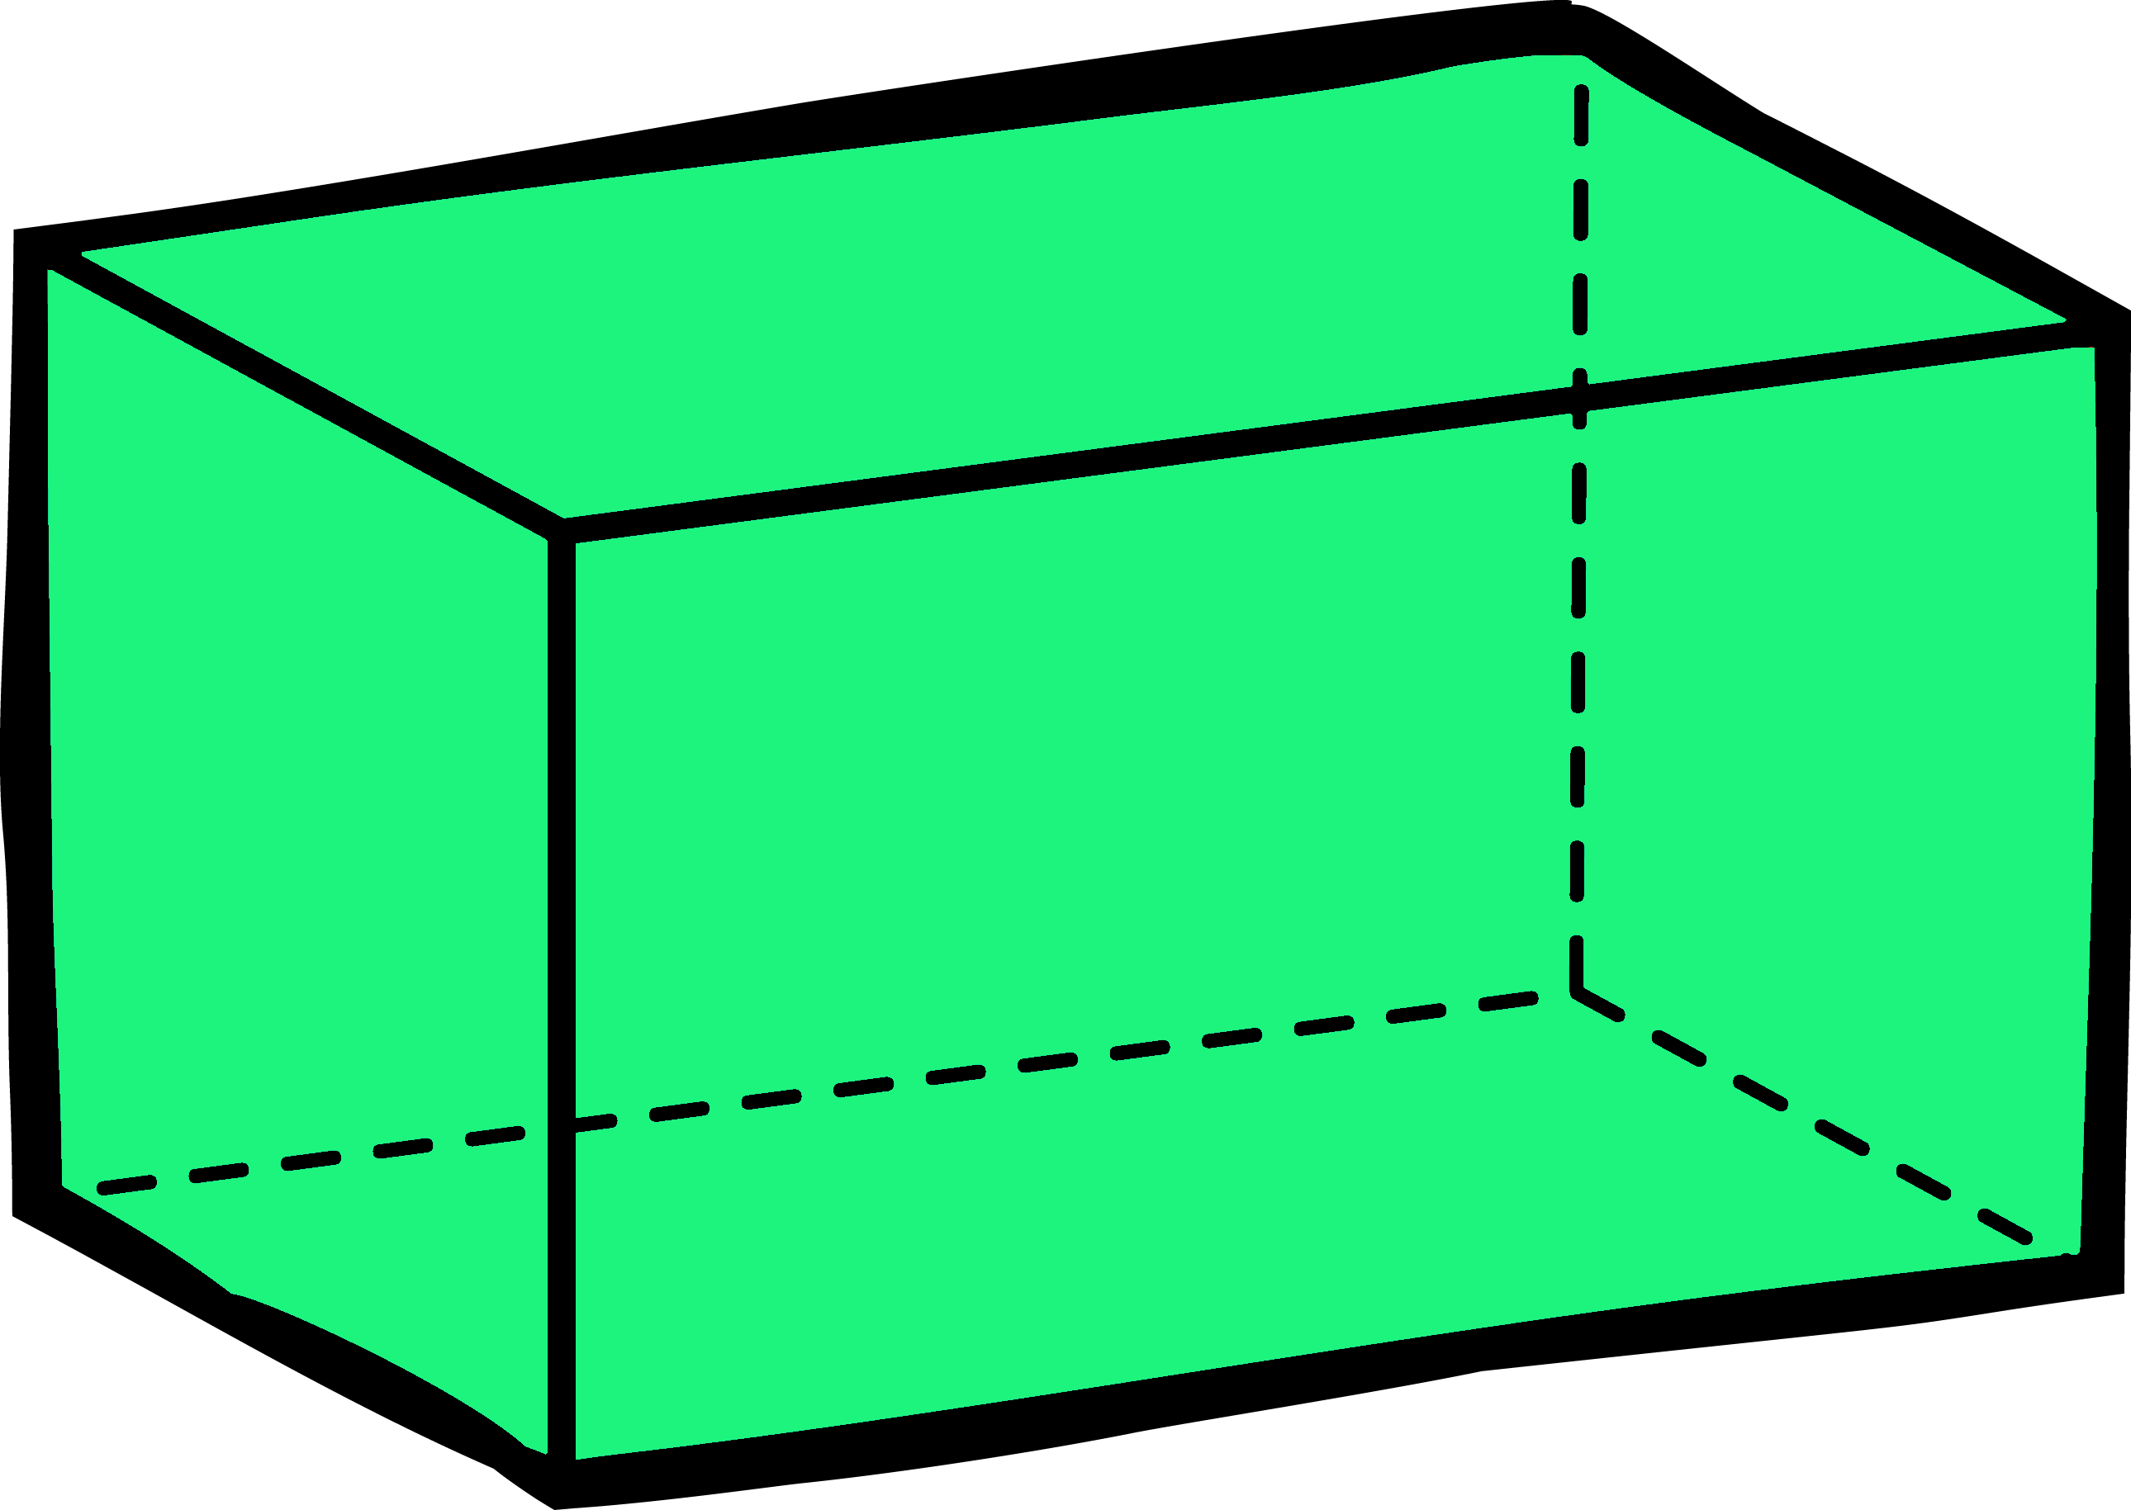
Fluency
Place the shapes into the correct groups.
Cylinders
Cuboids

Slide 19
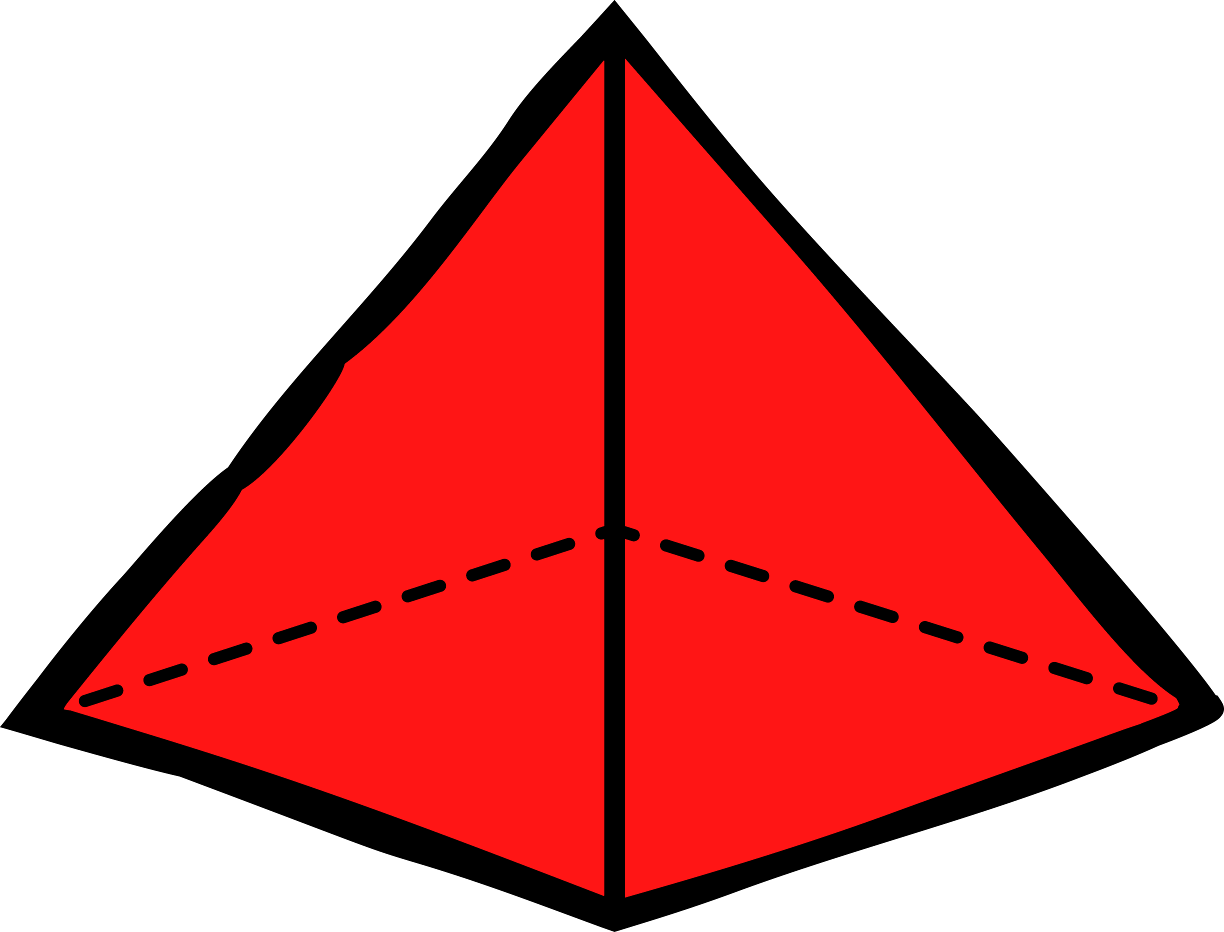
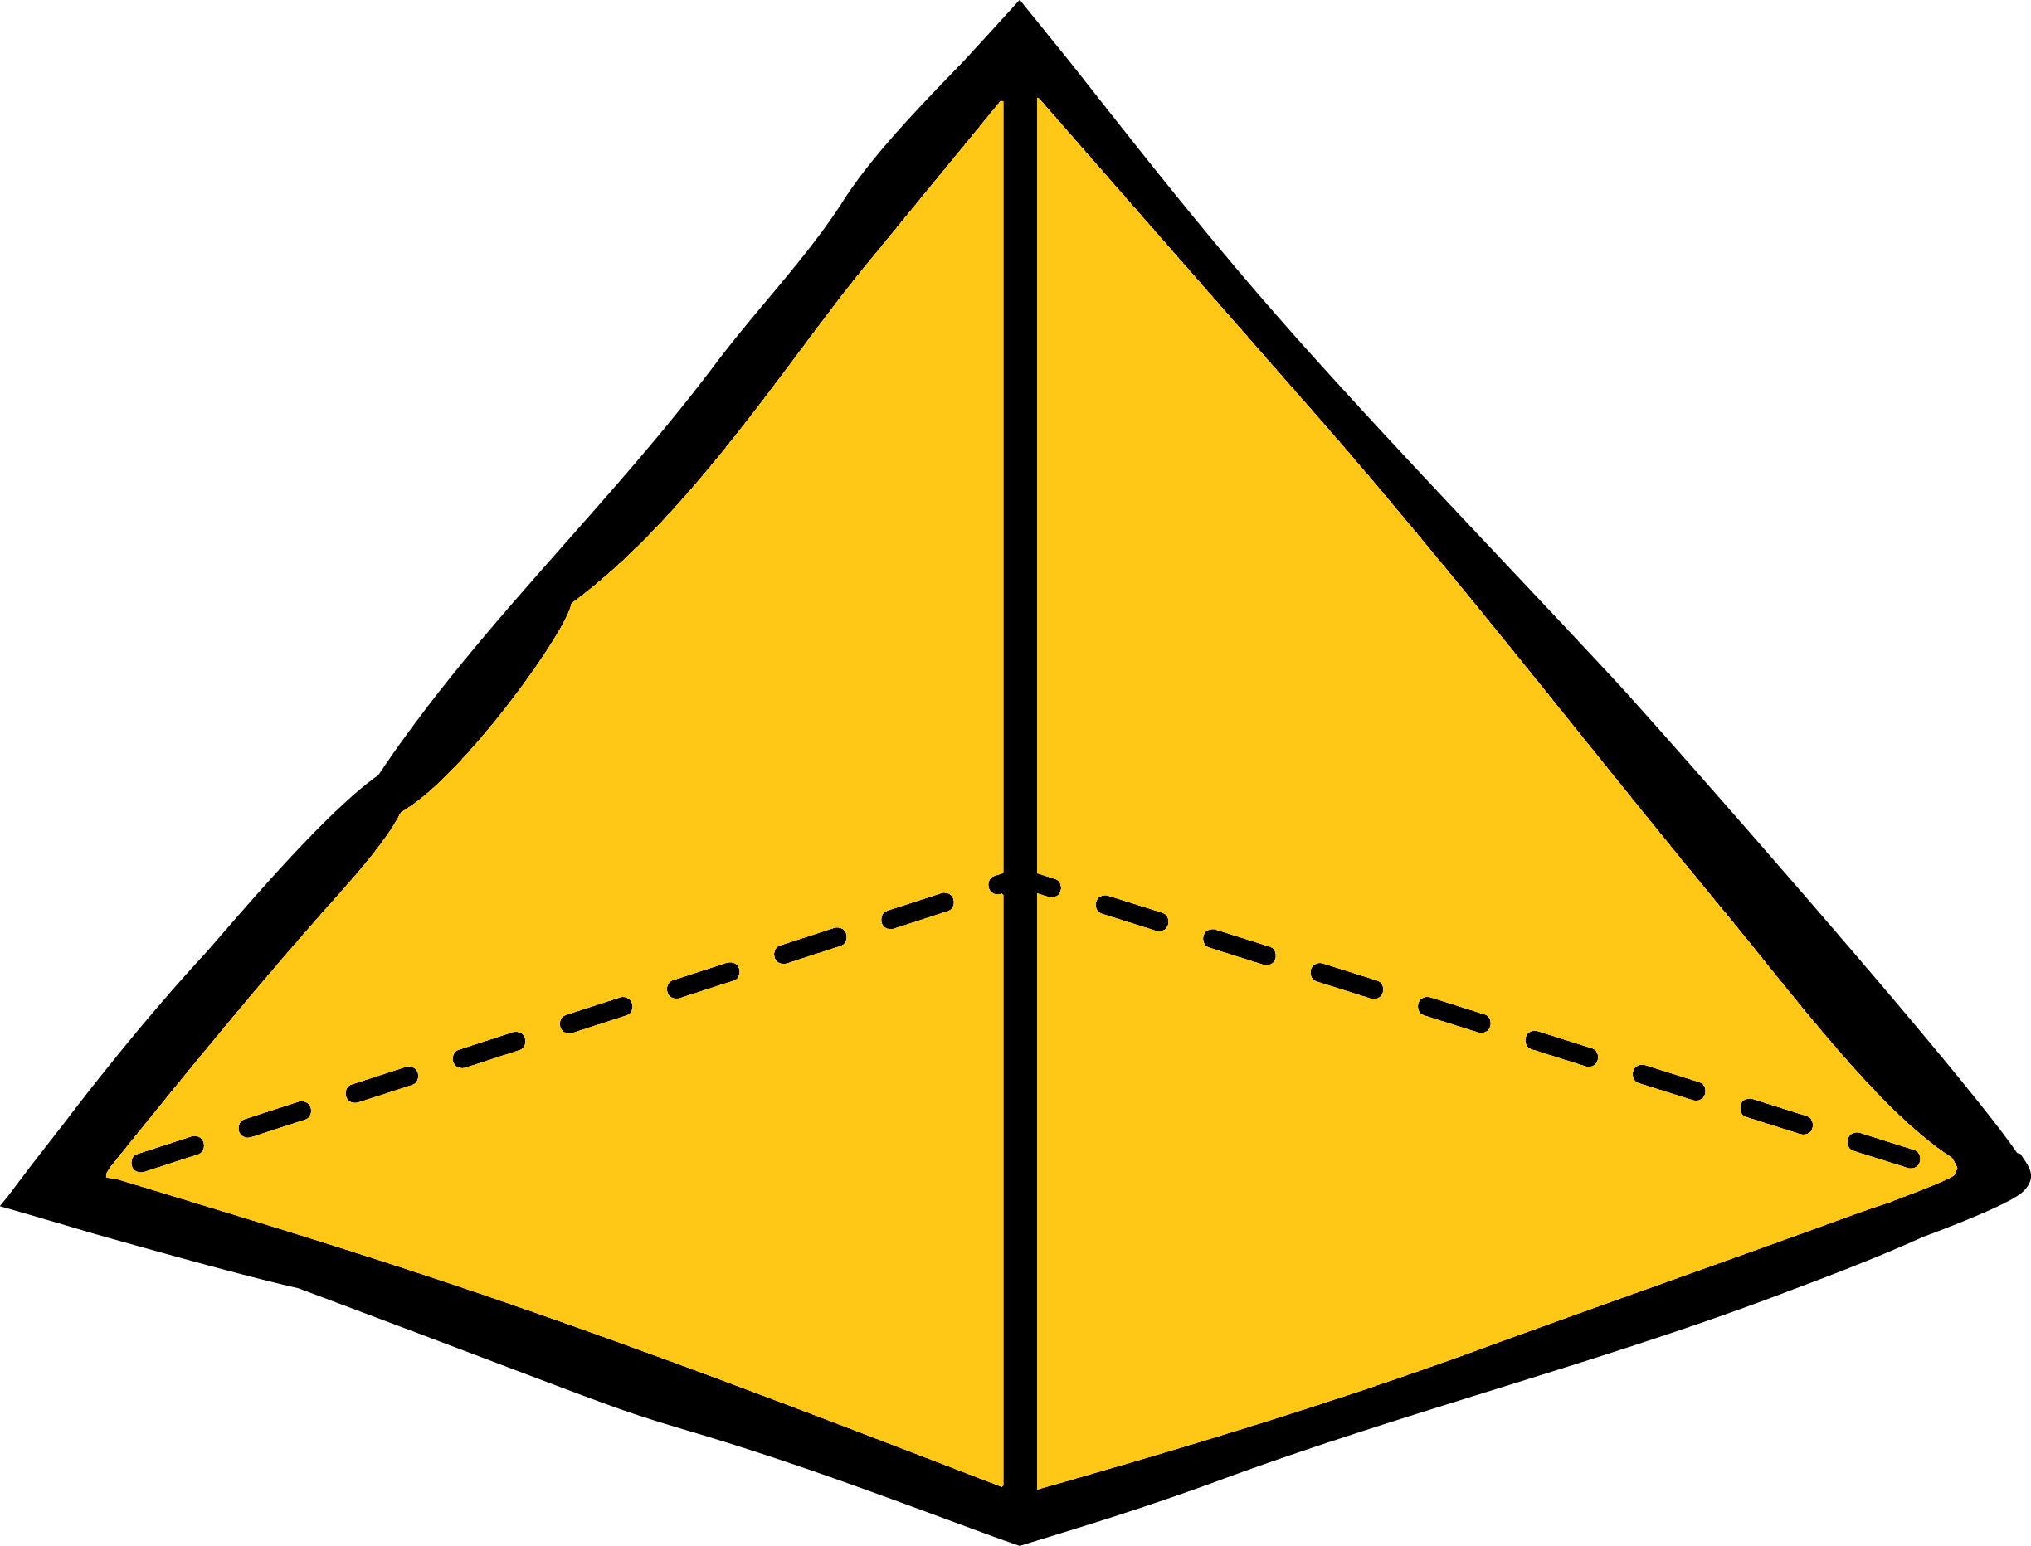
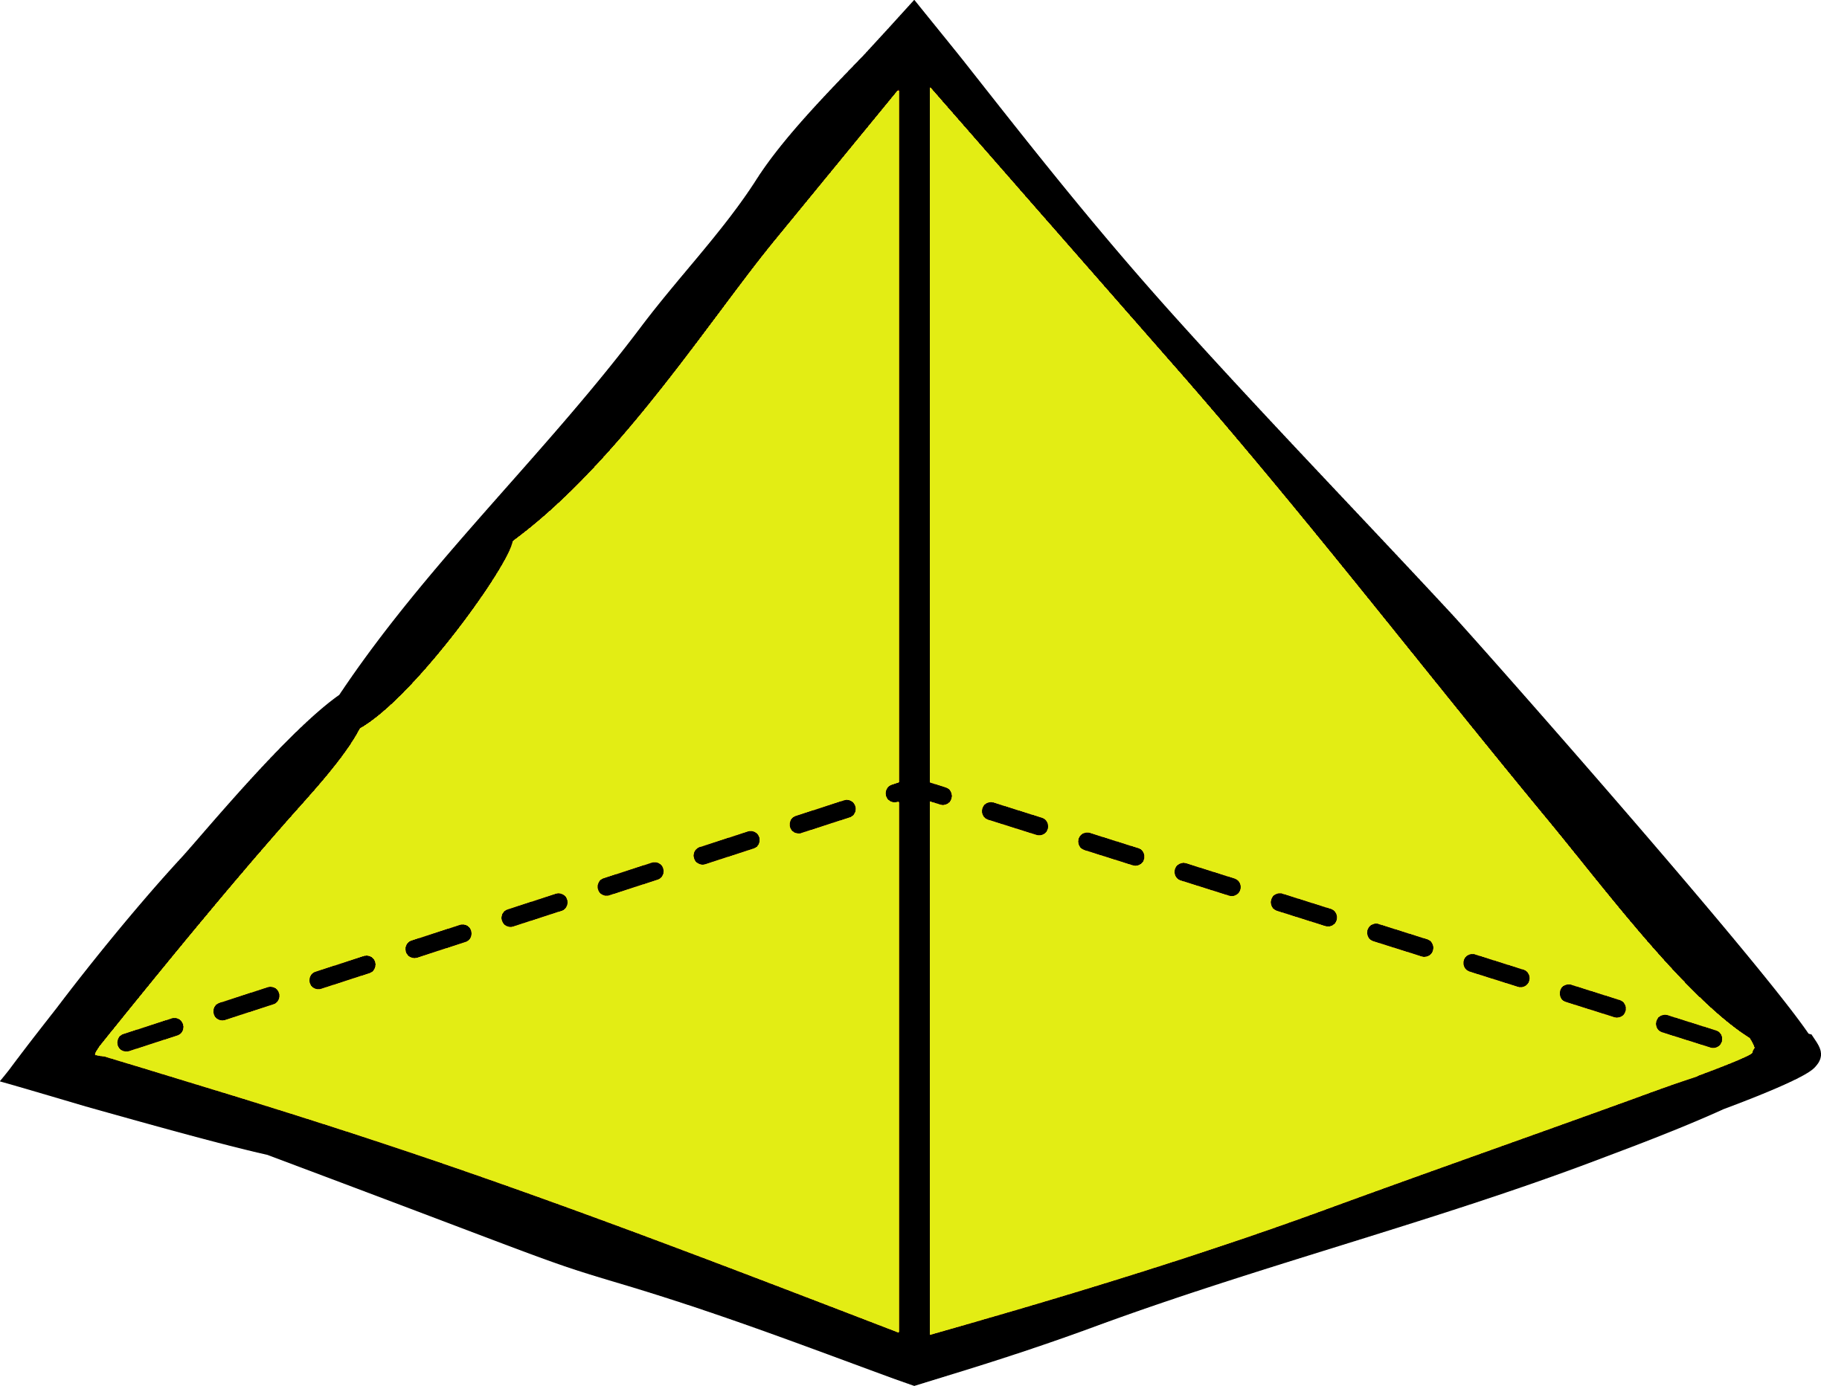
Fluency
Place the shapes into the correct groups.
Cones
Pyramids

Slide 20
A number of 3D shapes and objects have been sorted.
No
Have the shapes been sorted correctly? __________
Explain how you know.
The shapes have been sorted into cubes and cylinders.
The present is in the incorrect group. It should be with the cubes.

Slide 21
How could these shapes be sorted?
Big shapes / small shapes.
Yellow shapes / red shapes.
Cubes / spheres.

