Slide 1
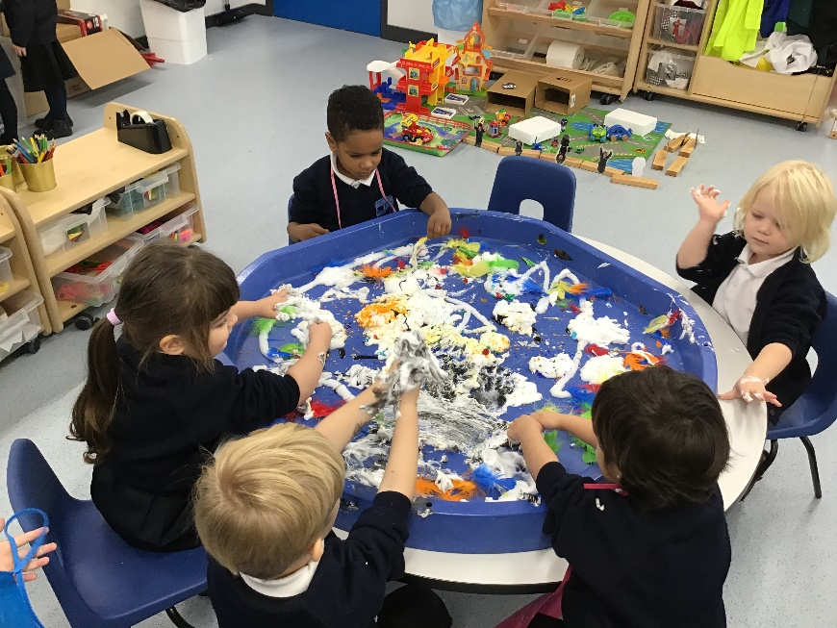
Brady Primary School Nursery
Prospectus
Brady Primary School
Wennington Road, Rainham, RM13 9XA
Phone: 01708 555025
Email: office@brady.havering.sch.uk
www.bradyprimaryschool.co.uk

Slide 2
Brady Primary School & Nursery
Dear Parents/ carers,
Hopefully this pack finds you all well and excited to start on your journey here at Brady Nursery.
We are very sad that we will not be able to run any stay and play sessions prior to your child/ren starting at Nursery but please rest assured that we cannot wait to meet them.
You will have been contacted by the school office for an initial chat and we hope in the following weeks to have a better idea about how your child/ren’s start to school (start dates etc.) will look.
We will be in touch as and when we know more information and hope you enjoy looking through this pack.
The Nursery Team ☺

Slide 3
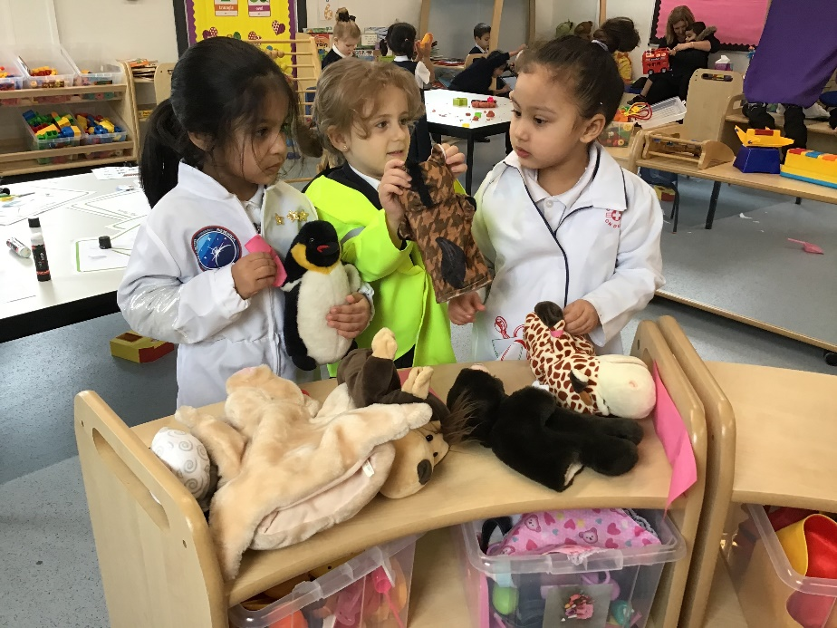
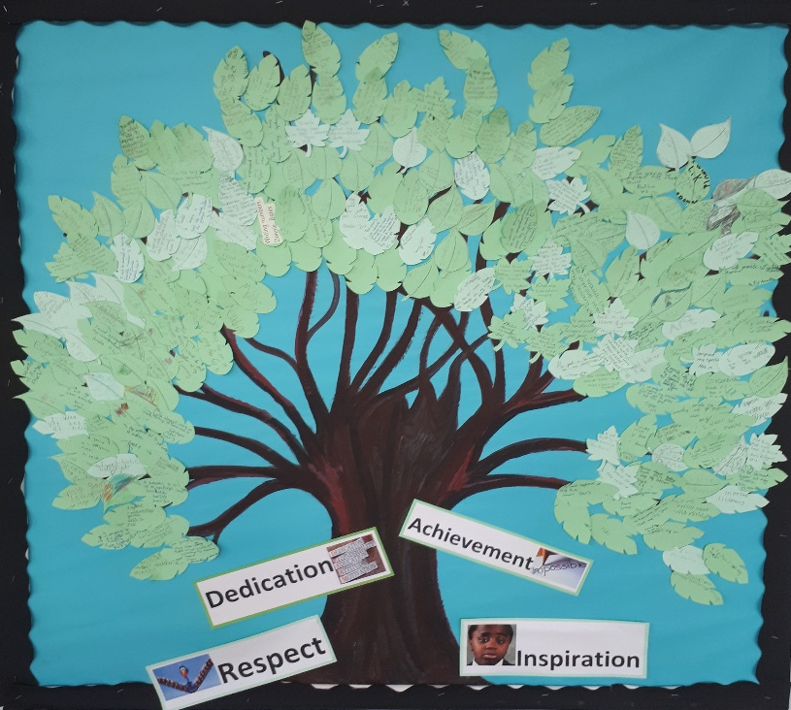
Welcome
Thank you for considering Brady Primary School Nursery as the right choice for your child. This document is intended to help you know more about the life and work of our school and nursery.
At Brady, we are dedicated to encouraging your child’s learning by offering a simulating and varied curriculum and a secure environment where all children can reach their potential.
The school’s ethos is built on four ‘Core Values’ Dedication, Inspiration, Respect and Achievement.
We strongly believe in enhancing our community feel to the school where staff and parents work in partnership for the best interests of
all children.
If you would like further details please contact the office on 01708 555025
Michael Nunn
Headteacher

Slide 4
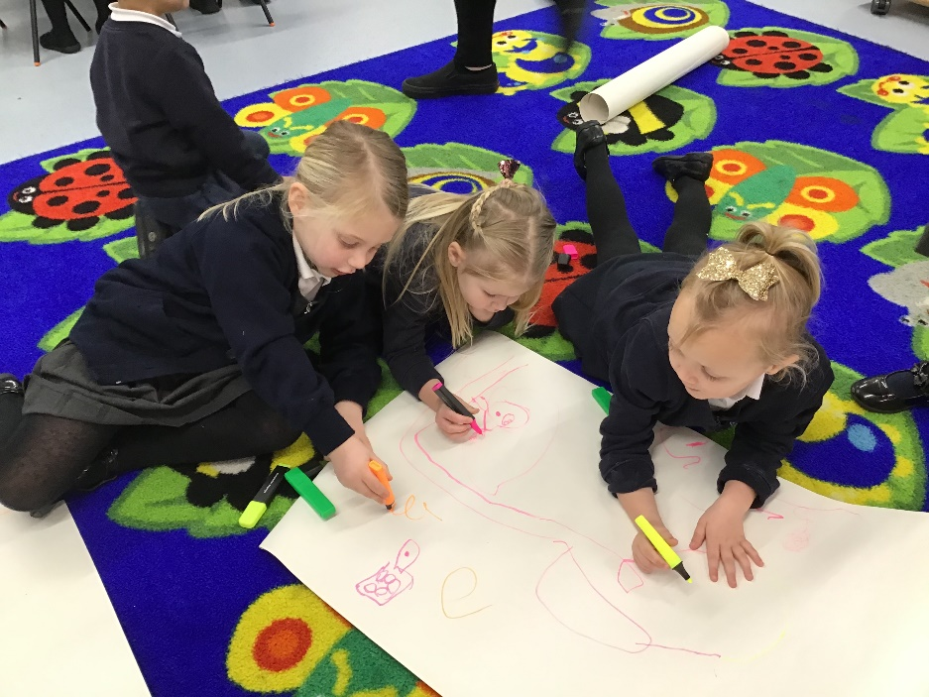
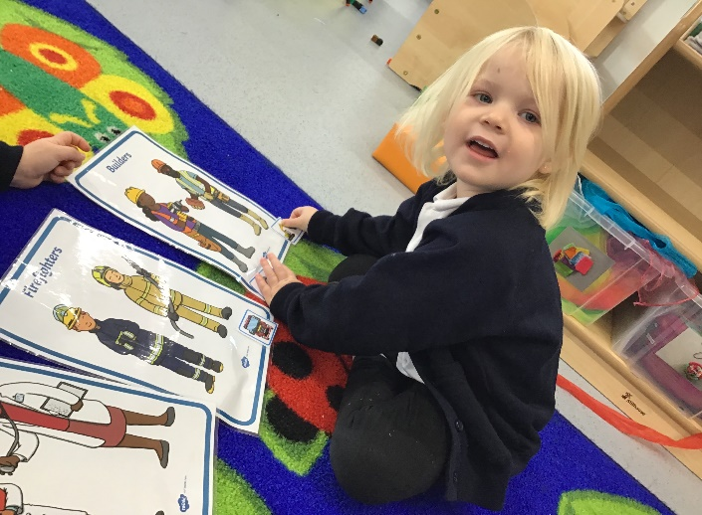
Our Nursery and Early Years Foundation Stage
The school’s values and beliefs are deeply rooted in our Early Years Provision; this supports our young children as they embark on their educational journey.
The Early Years are a time of ‘awe and wonder’ as children discover new things and explore the world around them. In our setting, children have opportunities to play, learn and develop as they experience a wide range of adult-led and child initiated activities.
Staff are experienced and skilled at building on what the children already know and understand.
The children’s learning and development is tracked all through the Foundation stage and into Key Stage One.
Our ethos embraces every child as an individual, we promote positive attitudes and respect for ourselves and others. We offer children rich experiences in a variety of situations, creating a learning environment which stimulates their appetite and curiosity.
“The leadership and management of Early Years is outstanding. The early years leader has high aspirations for the children” Ofsted 2017

Slide 5
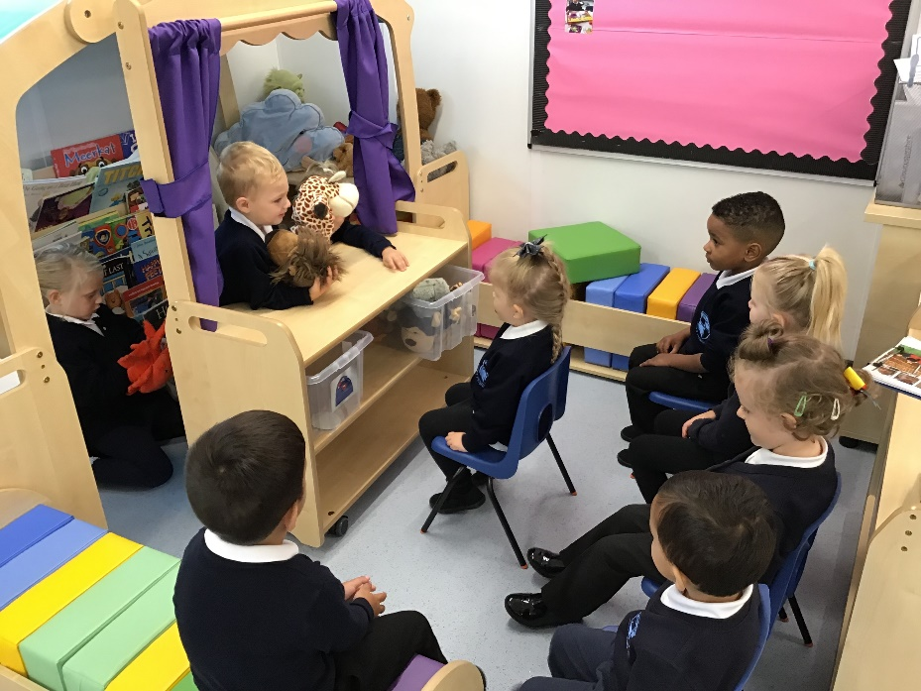
Our Aims
At Brady Nursery the emphasis is on learning through play and the provision of relevant first hand experiences that will extend and enrich the children’s understanding of the world around them.
We aim to:
Provide a safe, caring and stimulating environment in which children are able to develop their confidence and self-esteem.
Provide a motivating and stimulating environment that challenges children to achieve.
Ensure children have the opportunities to investigate, explore and play.
To provide the opportunities for children to develop their independence
and their love of learning, as well as develop relationships with others
around them.
Work closely with parents and carers in order to build effective
partnerships and relationships
Enhance the quality of teaching and learning through planned staff
development
Provide an inclusive environment where everyone is treated as an
individual.

Slide 6
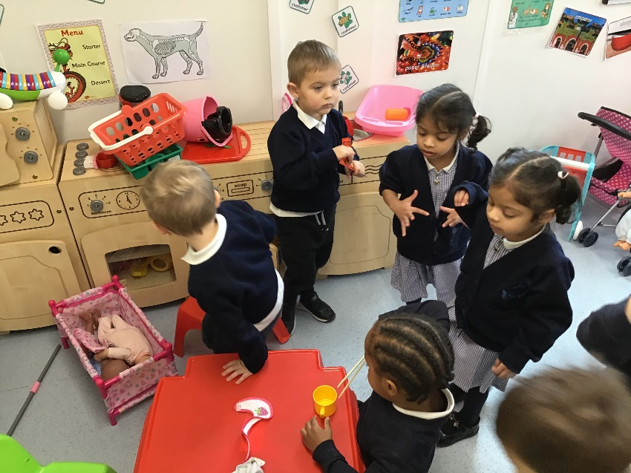
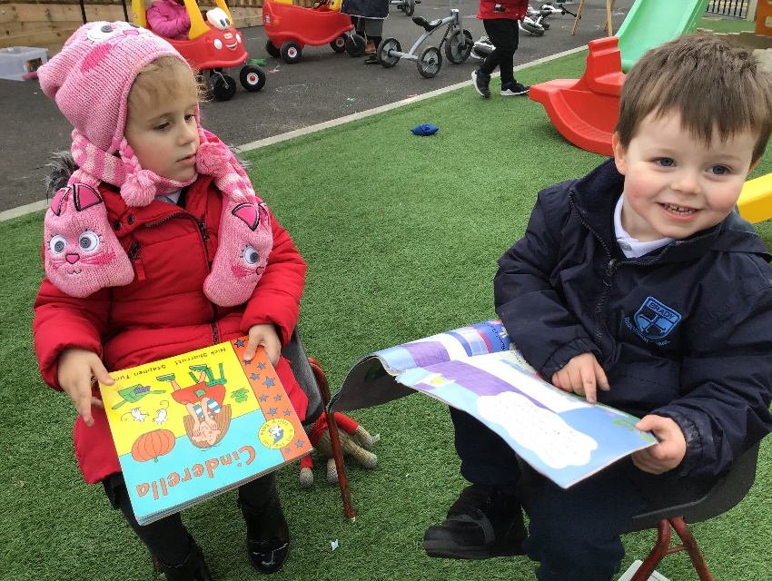
Nursery provision
Nursery (3- 4 Year Olds)
The nursery provides care for children from the age of 3 and
will be open during term times, less 5 INSET days in line with the school for
staff training. All staff are qualified, experienced, caring and committed
to ensuring that children receive the very best start in life.
Our introduction process will begin with nursery visits and stay and play
sessions. This helps to build a good working relationship between all parties.
All new starters to the nursery will take part in either a ‘Home Visit’ or an
arranged ‘In School Visit’ as part of this transition.
The brand new nursery provision has been designed and furnished to directly meet the needs of 3-4 year old children, it will have specifically designed spaces to enhance the learning of the children. This practice then follows on into Reception and beyond in the school.
The children have the opportunity to eat lunch in the school hall before the rest of the school and will therefore also have access to the outstanding hot meals that we offer the children. If you wish for your child to stay for lunch this will come with a charge- as detailed later in this pack.

Slide 7
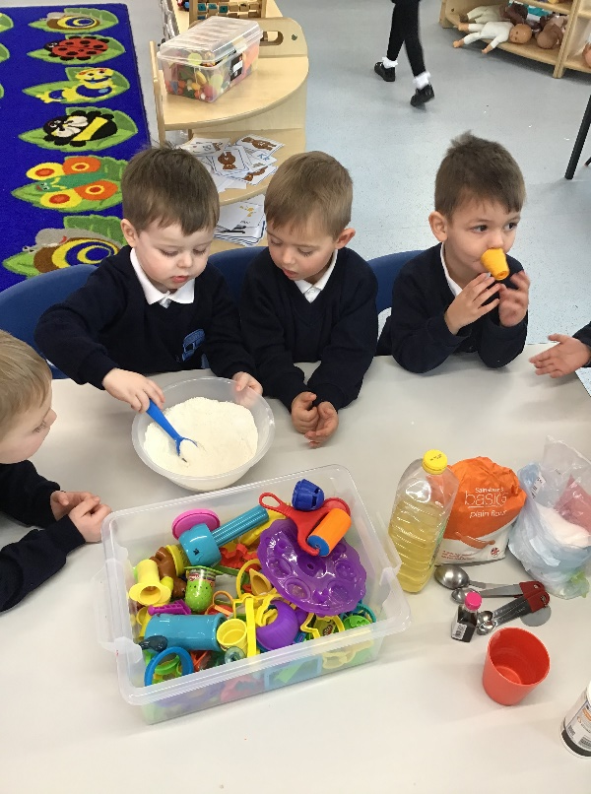
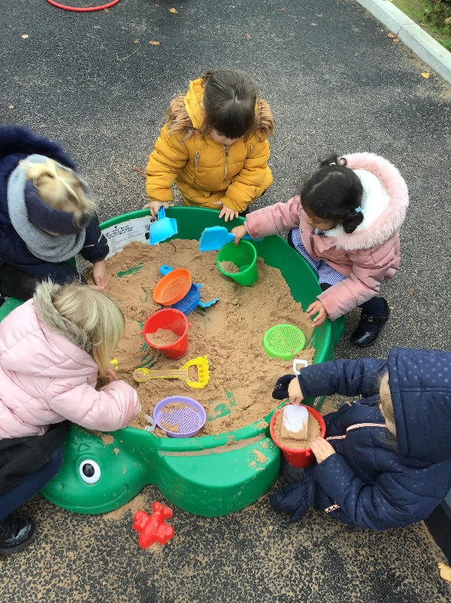
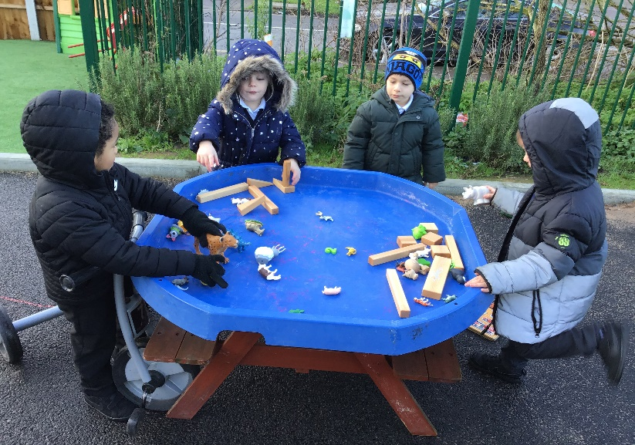
Extended Provision
In order to best meet the needs of the children and families we care for the nursery offers a minimum of 9 hours each week, in three hour blocks. Extended places are available to nursery children, enabling parents to extend their child’s core sessions, to include; breakfast, lunch and after school club.
Our before and after school club is run by the school. The hours are:
Breakfast club 7.45- 8.45
After school club 3.15- 6.00
Prices for 2020-2021 are yet to be confirmed

Slide 8
Fees and hours
These is no charge for the Core Sessions for those children eligible for the 15 hours Early Education Entitlement (EEE) or the additional 30 hour offer. Funding may be available the term after your child turns 3 for up to 15 hours a week. If you wish to request eligibility for the 30 hour offer, or Tax free childcare, this must be completed the term before they turn 3. Working parents may be entitled to both of these offers, for more information and to apply, please go to : www.childcarechoices.gov.uk . Parents that are eligible for universal credit may also be eligible for up to 85% of their childcare costs reimbursed https://www.gov.uk/help-with-childcare-costs/universal-credit
Hours
Breakfast club Trial in September dependant on uptake
Morning session 8.30am -11.30am
Afternoon session 12.30pm- 3.30pm
Lunchtime session 11.30am- 12.30pm
After school club dependant on uptake
Late collection fees
5 minutes = £0.00
5- 15 minutes = £5.00
Every 15 minutes after 12.45pm or 3.45pm = £10.00
Fees
Breakfast club TBC
Morning session £15.00
Afternoon session £15.00
Lunchtime session £5.00 (with a packed lunch from home)or £7.30 (with pre-ordered school hot dinner)
After school club TBC
Breakfast and afterschool club will only be open to Nursery children if there is sufficient demand for places.

Slide 9
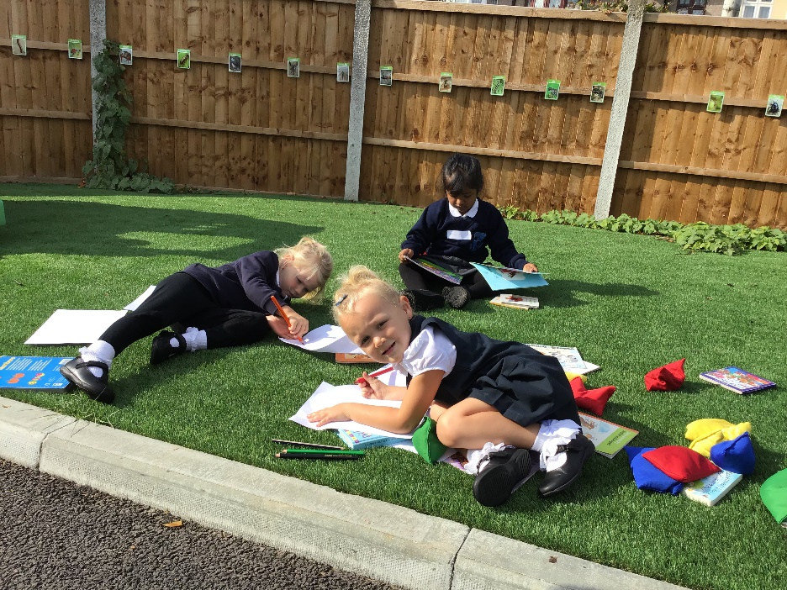
Fees and hours continued…
Only core sessions can be used for the children eligible for the Early Education Entitlement (EEE) or the additional 30 hour offer. EEE cannot be used for wraparound care such as breakfast, after school club or lunchtime provision.
Parents wishing to use their EEE as full day provision i.e 2 ½ days a week from 8.30- 3.30 will have to pay £5.00 a day for lunch as EEE sessions do not cover lunchtimes.
Parents are able to request the days their child attends nursery providing space is available. Six weeks notice is required in writing if you wish to cancel your child’s nursery place, or make additional arrangements and amendments.
All fees are payable a month in advance, failure to pay will result in the nursery place
being rescinded.
2 Year Old trial from September TBC
Some parents may be eligible for free 2 year old nursery provision:
https://www.gov.uk/help-with-childcare-costs/free-childcare-2-year-olds
Dependant on interest, there could be provision for 2 year olds between 12.30-3.30
each afternoon, parents who are not eligible for this offer can choose to pay for the
Sessions at a small cost.

Slide 10
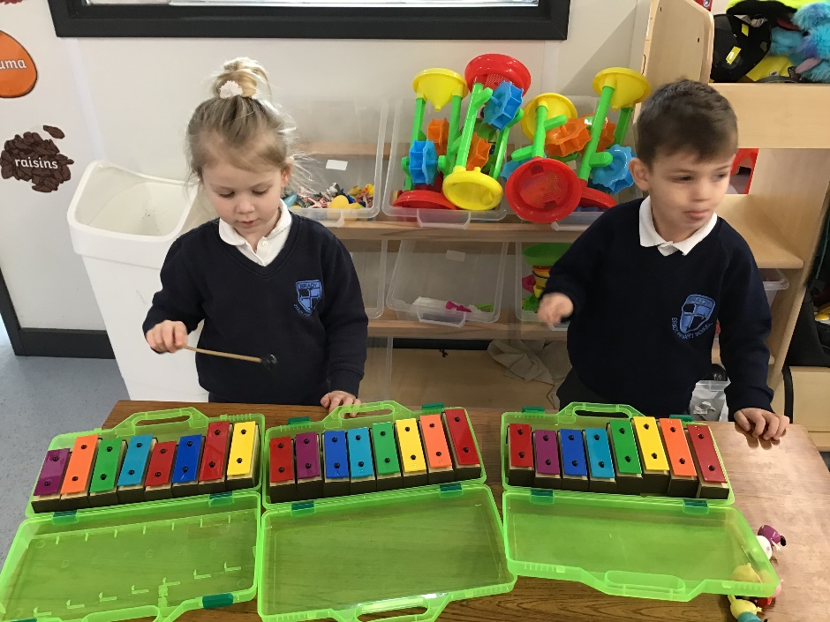
The Curriculum
The Brady Nursery curriculum follows the Themes, Principles and Practice of the Development Matters Framework. We recognise that every child is unique and ready to learn. We pride ourselves on ensuring that our Nursery provision is a purpose built, fully equipped, enabling environment for your child to flourish.
Our experienced, nurturing staff closely follow the Development Matters framework to embed positive, firm foundations for the children to begin their educational journey.
The curriculum is based upon Seven Areas of Learning:
Prime Areas
Personal, Social and Emotional Development
Communication and Language
Physical Development
Specific Areas
Literacy
Mathematics
Understanding the World
Expressive Arts and Design

Slide 11
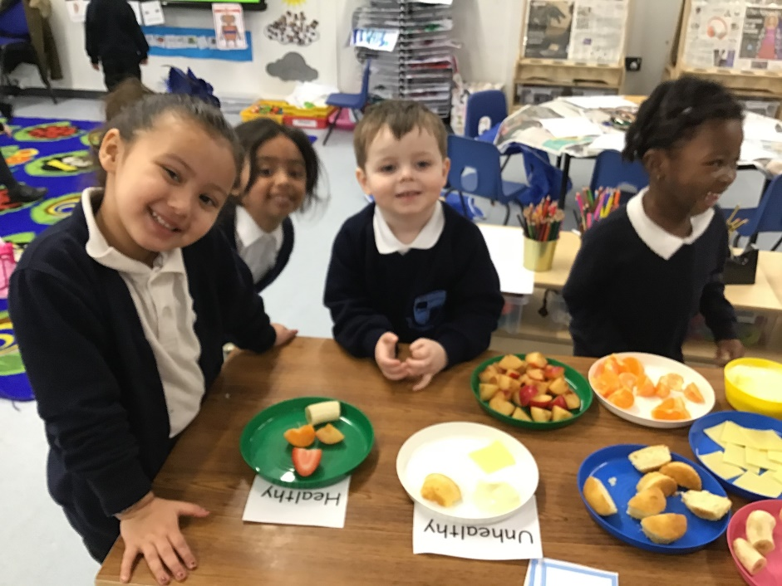
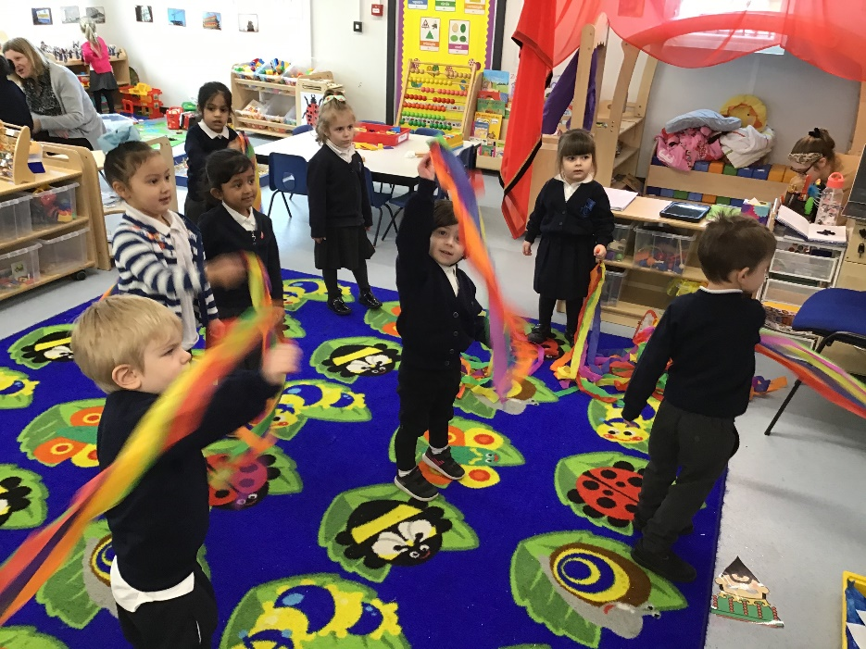
A day at Brady Nursery
A day at Brady Nursery is a always a creative, imaginative and fun day to be a part of.
Your child’s day will start at 8.30am or 12.30pm, where you will be greeted by your child’s teacher and your child will come into nursery, hang up their coat and bag and register their name.
Throughout the session there will be structured carpet time opportunities for the children to hear stories shared, play games and make music. At all other times, the children will have access to the many activities and resources embedded in the setting – from sand and water play, to construction and mark-making.
Staff will prioritise children’s individual and developmental learning needs and
structure small group work throughout the session to progress your child’s
learning and understanding.
For example, they may focus on counting objects to improve early number skills or
use specific language to improve vocabulary, such as ‘heavier, lighter than’ etc. at the playdoh table.
Your child will have lunch at 11.30am if you have opted for this additional
session, and will come back to the nursery garden to play until lunch finishes
at 12.30

Slide 12
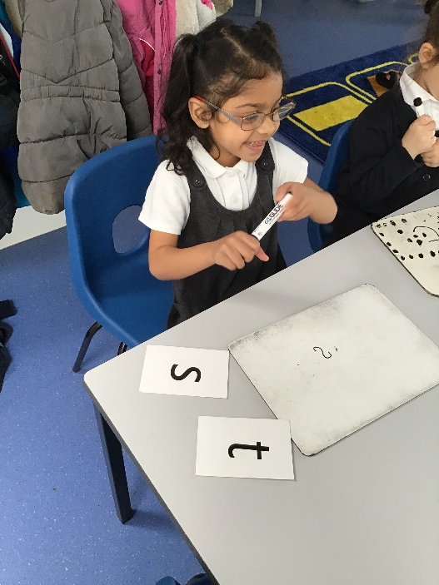
Registering for a place
1, Children can be put on the waiting list at any time, no fee is charged to put a child on the waiting list.
2, Parents should make an appointment to look around the Nursery and wider school, or attend open evenings/ days. You will then be asked to complete a registration form.
3, Places will be offered in line with the Havering Admissions Policy as set out below:
Children looked after or previously looked after
Children with special educational needs
Siblings of children in the school
Distance from home to school
4, Free entitlement place may be available from the term after your child turns 3 years of age. The cut off days for each term are 31st August/ 31st December/ 31st March.
If you wish to request a 30 hour place this must take place the term before your child turns 3 years of age.
Parents will be expected to sign a contract if offered a place in the nursery.
To show your commitment, we ask that this contract is returned promptly. We will have one main intake a year, in September. However, occasionally places may become available at other times. Places for September will be allocated from March the year before.
Once you have been offered a place you will also have a stay and play session in September to help your child’s transition into the nursery. This is a great chance for you and your child to meet the staff and begin to form a strong partnership to work together.

Slide 13
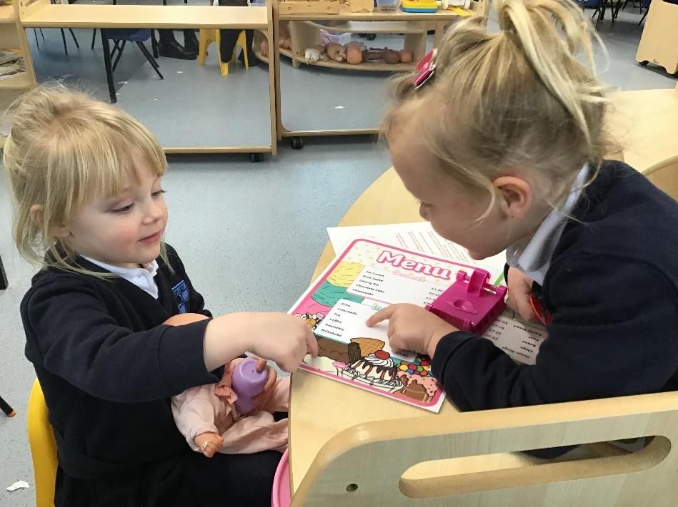
Children’s individual needs
At Brady, we believe that all children have the right to a first class education. To do this we ensure that children’s needs are identified and planned for to help create the most appropriate curriculum for them.
Some children are given extra support and guidance where needed from our team of highly trained staff. To help us meet the children’s special needs, we follow the National ‘Special Educational Needs and Disability Code of Practice’. Details of the school’s offer for children with SEND and Havering’s local offer can be found on the school website or in the school office.
As with all schools we also have a portion of children who are learning English as an additional language. Our language rich environment within the nursery and the school enables these children to make rapid progress in developing their skills in English.
“Support for pupils who have special educational needs and/or disabilities is well planned
and effective. As a result, these pupils are making good progress in most of their
subjects”. – Ofsted 2017
Help is always available for children with Special Educational Needs (SEND). All staff are
involved in this process, through identification and support.
The Foundation Stage Leader (Mrs Divall), in conjunction with our SENCO (Mrs Zaayman)
help to oversee this provision for the Nursery and in turn the whole school.

Slide 14
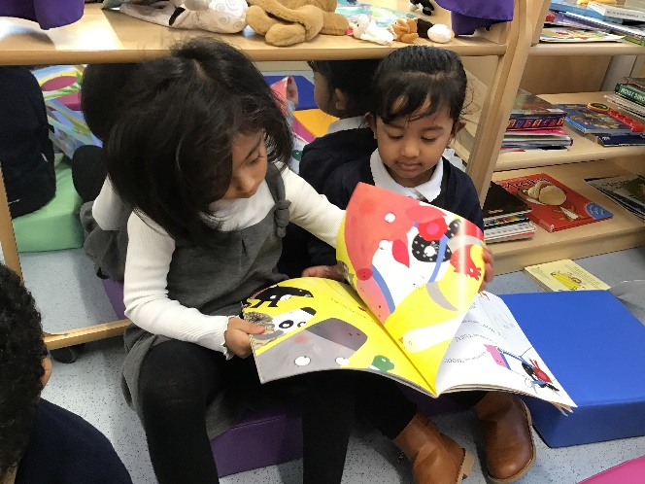
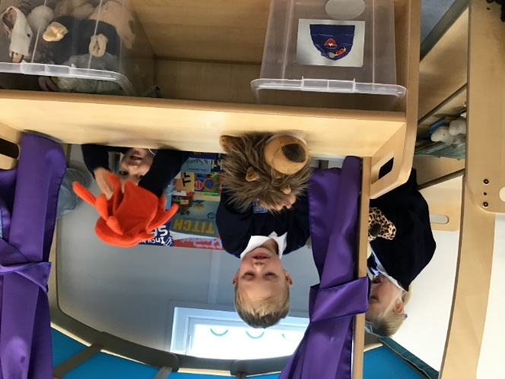
Behaviour
“The school’s personal development and welfare is outstanding. Staff and pupils understand the importance of taking care of each other at all times, pupils feel very safe in school ” Ofsted 2017
At Brady we are proud of the ‘Outstanding’ behaviour we have, we work hard as a school to ensure that this is the case through the use of positive praise and reinforcement. We provide a supportive and positive learning environment in which the children feel comfortable
And can express themselves.
All staff have high expectations for
behaviour both in school and on
school trips.
As a school we also work in
partnership with parents and
carers to ensure that the children’s
needs are being met.
Parents/ Carers
There are many ways in which you as parents can support your child/children when they are at Nursery.
You are always welcome in school. When your child has settled; you may like to join us as one of our volunteers on a regular or occasional basis. There are many ways in which you can help, either with your child’s activities or by sharing any specific skills you may have.
We also run courses through the adult college which may help you to assist your child at home- these are all free of charge to you as parents.
We hold shared learning afternoons where you are welcomed into school to work with your child for the afternoon.
During the course of the year we also have 2 parents evenings and an end of year report.

Slide 15
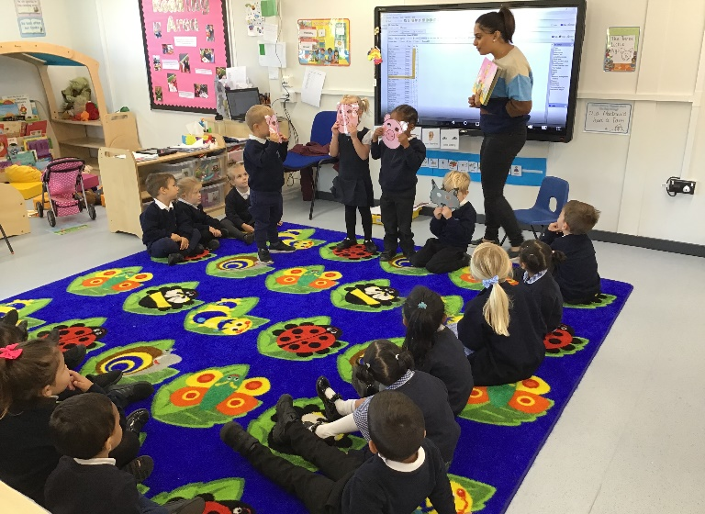
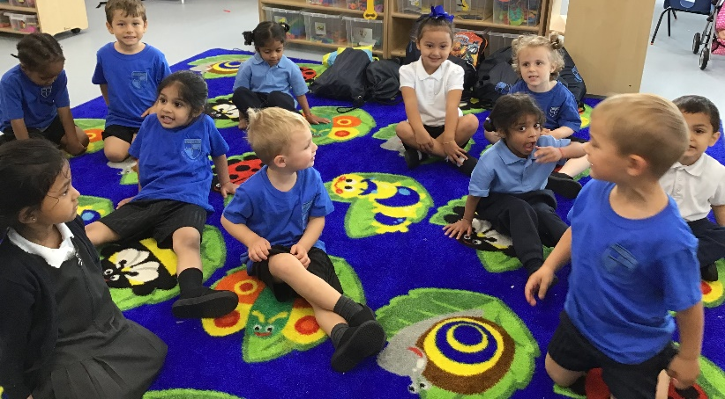
Equality
We ensure that all children, irrespective of gender, race or ethnicity, have the opportunity to achieve well and meet their full potential. We all adhere to the Brady Primary School Equality Policy.
Security in the Nursery
All staff are well trained and conscious of the need for tight, unobtrusive,
security within the nursery and the whole school. All visitors must report to
the office and be signed in and out of the building. Any unknown person, not
wearing a visitors badge will be challenged by all members of staff.
All adults who work with children in the school are subject to enhanced
DBS checks.
Uniform
Nursery children will wear a white polo t-shirt (with or without a
school logo) with plain black tracksuit bottoms and a school jumper.
Sensible closed shoes should be worn (no sandals, flip-flops or boots).
Nursery children should also bring with them a PE kit for when it is their term to
take part in PE lessons (blue Brady t-shirt, shorts and plimsoles).
Uniform bearing the school logo can be purchased from Premier School wear http://www.premierschoolwear.co.uk/

Slide 16
We know that everything is a bit uncertain at the moment, but one thing that is certain is that we cannot wait to meet you.
If you have got any questions, you can ask us soon or contact us at the details on the front page.
Have a lovely summer and see you soon!
The Brady EYFS Team ☺

